Slide 1

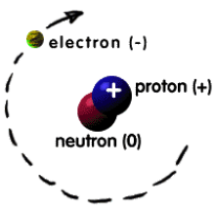
The Atomic Theory

Slide 2
Cont...
Atomic structure
Atom is the smallest particle of matter that has the properties of an element
The atomic structure of an element refers to the constitution of its nucleus and the arrangement of the electrons around it.
Primarily, the atomic structure of matter is made up of protons, electrons, and neutrons.
The protons and neutrons make up the nucleus of the atom, which is surrounded by the electrons belonging to the atom.
The atomic number of an element describes the total number of protons in its nucleus

Slide 3
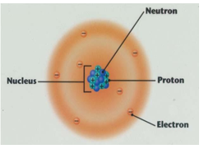
Cont...
Consider
In the 18th and 19th centuries, many scientists attempted to explain the structure of the atom with the help of atomic models.
Each of these models had its own merits and demerits and was pivotal to the development of the modern atomic model.
The most notable contributions to the field were by scientists such as John Dalton, J.J. Thomson, Ernest Rutherford, and Niels Bohr.
Their ideas on the structure of the atom are discussed in the following subsections

Slide 4
Cont...
Dalton’s Atomic Theory
The English chemist John Dalton suggested that all matter is made up of atoms, which were indivisible and indestructible.
He also stated that all the atoms of an element were exactly the same, but the atoms of different elements differ in size and mass.
Chemical reactions, according to Dalton’s atomic theory, involve a rearrangement of atoms to form products.
The following are the postulates of Dalton’s Atomic Theory
Every matter is made up of atoms.
Atoms are indivisible.
Specific elements have only one type of atom in them.
Each atom has its own constant mass that varies from element to element.
Atoms undergo rearrangement during a chemical reaction.
Atoms can neither be created nor destroyed but can be transformed from one form to another.

Slide 5
Cont...
Dalton’s atomic theory successfully explained the Laws of chemical reactions that are
The law of conservation of mass
The mass of a system is not affected by any chemical change within the system.
The law of definite proportions.
A particular chemical compound always contains the same elements united in the same proportions by weight
Demerits of Dalton’s Atomic Theory
The theory was unable to explain the existence of isotopes.
Nothing about the structure of the atom was appropriately explained.
Later, scientists discovered particles inside the atom that proved the atoms are divisible.

Slide 6
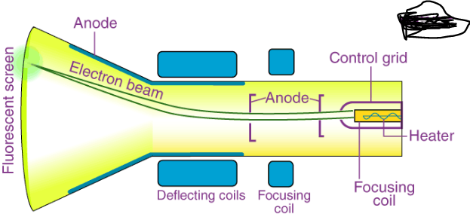
Cont...
Thomson Atomic Model
The English chemist Sir Joseph John Thomson put forth his model describing the atomic structure in the early 1900s.
He was later awarded the Nobel Prize for the discovery of “electrons”.
His work is based on an experiment called the cathode ray experiment.
The construction of working of the experiment is as shown on the figure
Consider

Slide 7
Cont...
Observations
When a high voltage power supply is switched on, rays emerge from the cathode towards the anode.
This was confirmed by the ‘Fluorescent spots’ on the ZnS screen used.
These rays were called “Cathode Rays”.
When an external electric field is applied, the cathode rays get deflected towards the positive electrode, but in the absence of an electric field, they travel in a straight line.
When rotor Blades are placed in the path of the cathode rays, they seem to rotate.
This proves that the cathode rays are made up of particles of a certain mass so that they have some energy.
With all this evidence, Thompson concluded that cathode rays are made of negatively charged particles called “electrons”.

Slide 8
Cont...
Conclusions made
Based on cathode ray experiment, Thomson described the atomic structure as a positively charged sphere into which negatively charged electrons were embedded.
It is commonly referred to as the “plum pudding model”
Because it can be visualized as a plum pudding dish where the pudding describes the positively charged atom and the plum pieces describe the electrons.
Thomson’s atomic structure described atoms as electrically neutral, i.e., the positive and the negative charges were of equal magnitude.
Limitations of Thomson’s Atomic Structure
Thomson’s atomic model does not clearly explain the stability of an atom.
Also, further discoveries of other subatomic particles couldn’t be placed inside his atomic model.

Slide 9
Cont...
Rutherford Atomic Theory
Rutherford, was a student of J. J. Thomson
He modified the atomic structure with the discovery of another subatomic particle called “Nucleus”
His atomic model is based on the Alpha ray scattering experiment.
Observations made
Most of the rays just went through the gold foil, making some bright spots in the screen.
A few rays got reflected after hitting the gold foil.
One in 1000 rays got reflected by an angle of 180° (retraced path) after hitting the gold foil.

Slide 10
Cont...
Conclusions made
Since most rays passed through, Rutherford concluded that most of the space inside the atom is empty.
A few rays got reflected because of the repulsion of its positive with some other positive charge inside the atom.
1/1000th of the rays got strongly deflected because of a very strong positive charge in the center of the atom.
He called this strong positive charge “nucleus”.
He said most of the charge and mass of the atom resides in the nucleus.
Note:
Based on the above observations and conclusions, Rutherford proposed his atomic structure, which is as follows.
The nucleus is at the center of an atom, where most of the charge and mass is concentrated.
The atomic structure is spherical.
Electrons revolve around the nucleus in a circular orbit, similar to the way planets orbit the sun.

Slide 11
Cont...
Limitations of the Rutherford Atomic Model
If electrons have to revolve around the nucleus, they will spend energy, and that too against the strong force of attraction from the nucleus, a lot of energy will be spent by the electrons, and eventually, they will lose all their energy and will fall into the nucleus so the stability of atom is not explained.
If electrons continuously revolve around the ‘nucleus’, the type of spectrum expected is a continuous spectrum. But in reality, what we see is a line spectrum

Slide 12
Cont...
Bohr’s Atomic Theory
Neils Bohr put forth his model of the atom in the year 1915.
This is the most widely used atomic model to describe the atomic structure of an element which is based on Planck’s theory of quantization.
He marked the beginning of a new era in atomic structure and spectroscopy
Bohr’s theory provided a satisfactory explanation of the Balmer, Lyman, and Paschen series of the hydrogen atom and the series of ionized helium
Also, he calculated the Rydberg constant based on purely theoretical considerations
His theory gave physical meaning to the experimental discovery that the frequency of the spectral lines is given by the difference between two terms
Bohr modified Rutherford’s model by using the plank’s quantum theory of radiation
He assumed that the hydrogen atom consists of a stationary nucleus (proton) at the center of the atom whose mass is 1836 times the mass of the electron
According to him, a single electron revolves around the stationary nucleus

Slide 13
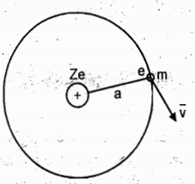
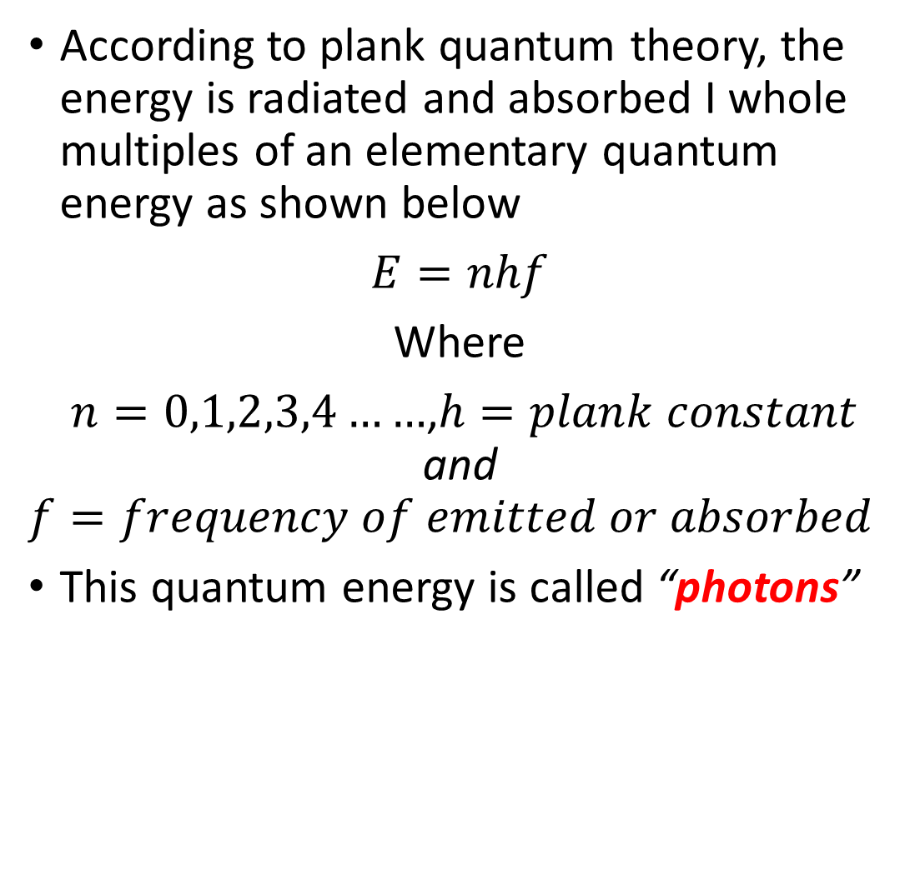
Cont...
Consider
According to plank quantum theory, the energy is radiated and absorbed I whole multiples of an elementary quantum energy as shown below
$E=nhf$
Where
$n=0,1,2,3,4……$,$h=plank constant$ and
$$f=frequency of emitted or absorbed$$
This quantum energy is called “photons”

Slide 14
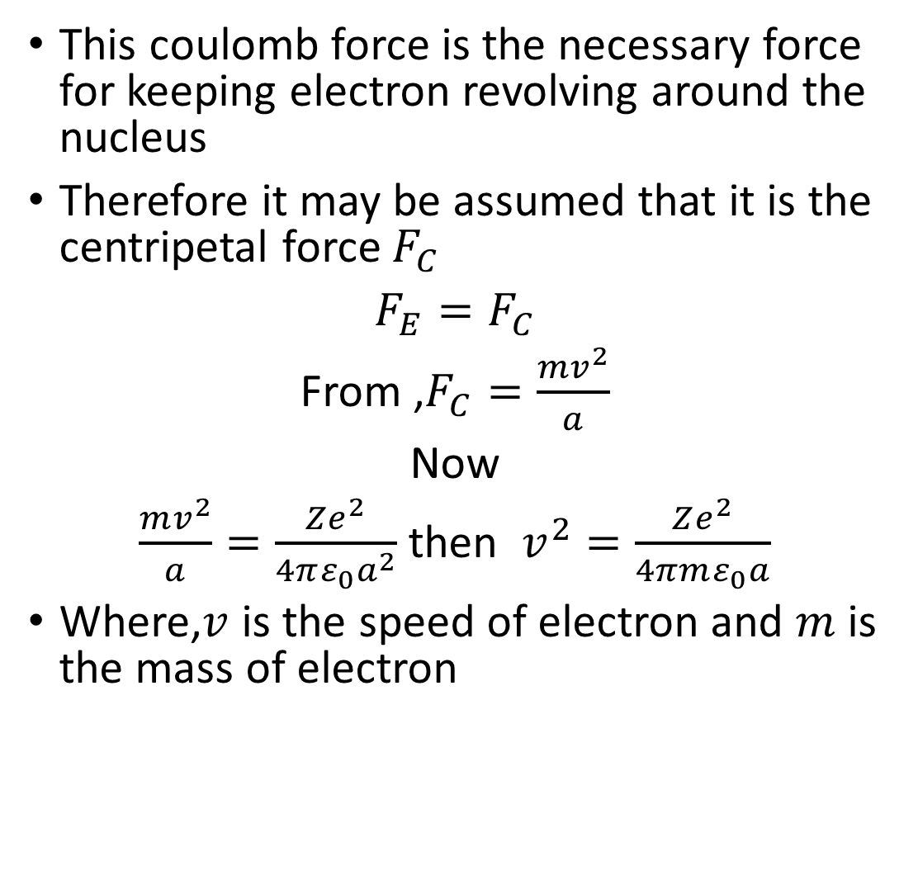
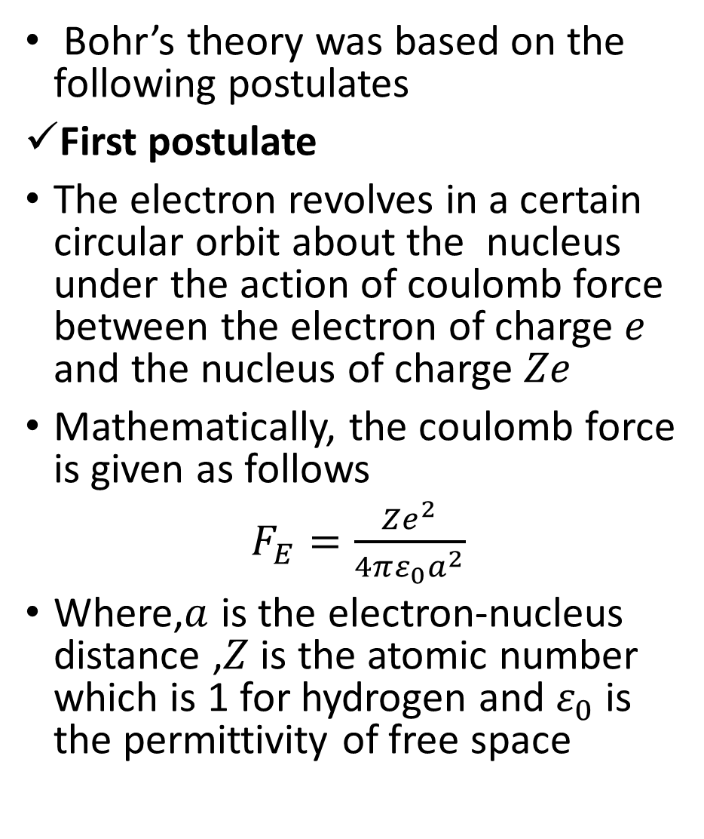
Cont...
Bohr’s theory was based on the following postulates
First postulate
The electron revolves in a certain circular orbit about the nucleus under the action of coulomb force between the electron of charge $e$ and the nucleus of charge $Ze$
Mathematically, the coulomb force is given as follows
$F_{E}=\frac{Ze^{2}}{4πε_{0}a^{2}}$
Where,$a$ is the electron-nucleus distance ,$Z$ is the atomic number which is 1 for hydrogen and $ε_{0}$ is the permittivity of free space
This coulomb force is the necessary force for keeping electron revolving around the nucleus
Therefore it may be assumed that it is the centripetal force $F_{C}$
$F_{E}=F_{C}$
From ,$F_{C}=\frac{mv^{2}}{a}$
Now
$\frac{mv^{2}}{a}=\frac{Ze^{2}}{4πε_{0}a^{2}}$ then $v^{2}=\frac{Ze^{2}}{4πmε_{0}a}$
Where,$v$ is the speed of electron and $m$ is the mass of electron

Slide 15
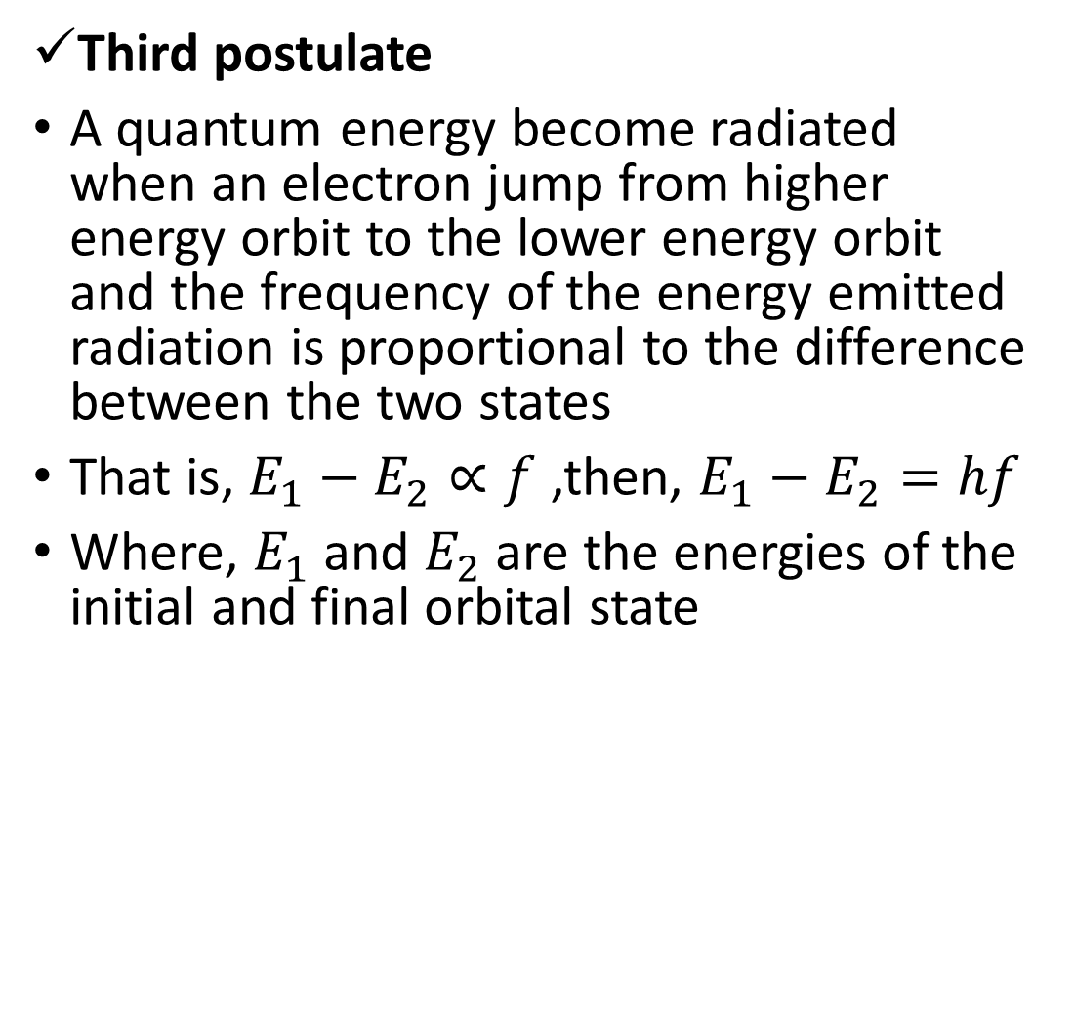
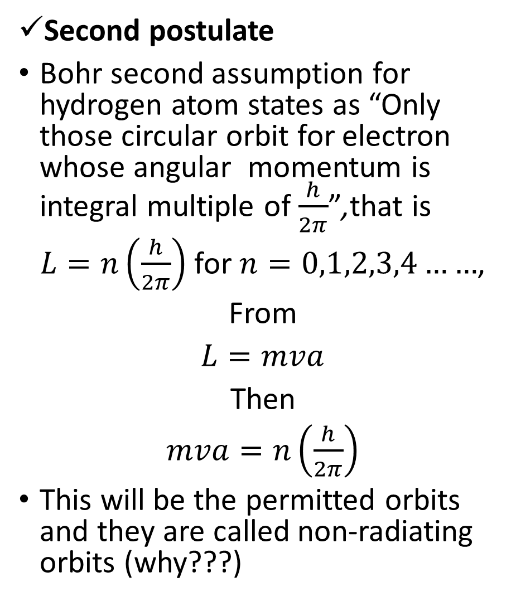
Cont...
Second postulate
Bohr second assumption for hydrogen atom states as “Only those circular orbit for electron whose angular momentum is integral multiple of $\frac{h}{2π}$”,that is
$L=n\left(\frac{h}{2π}\right)$ for $n=0,1,2,3,4……$,
From
$L=mva$
Then
$mva=n\left(\frac{h}{2π}\right)$
This will be the permitted orbits and they are called non-radiating orbits (why???)
Third postulate
A quantum energy become radiated when an electron jump from higher energy orbit to the lower energy orbit and the frequency of the energy emitted radiation is proportional to the difference between the two states
That is, $E_{1}−E_{2}∝f$ ,then, $E_{1}−E_{2}=hf$
Where, $E_{1}$ and $E_{2}$ are the energies of the initial and final orbital state

Slide 16
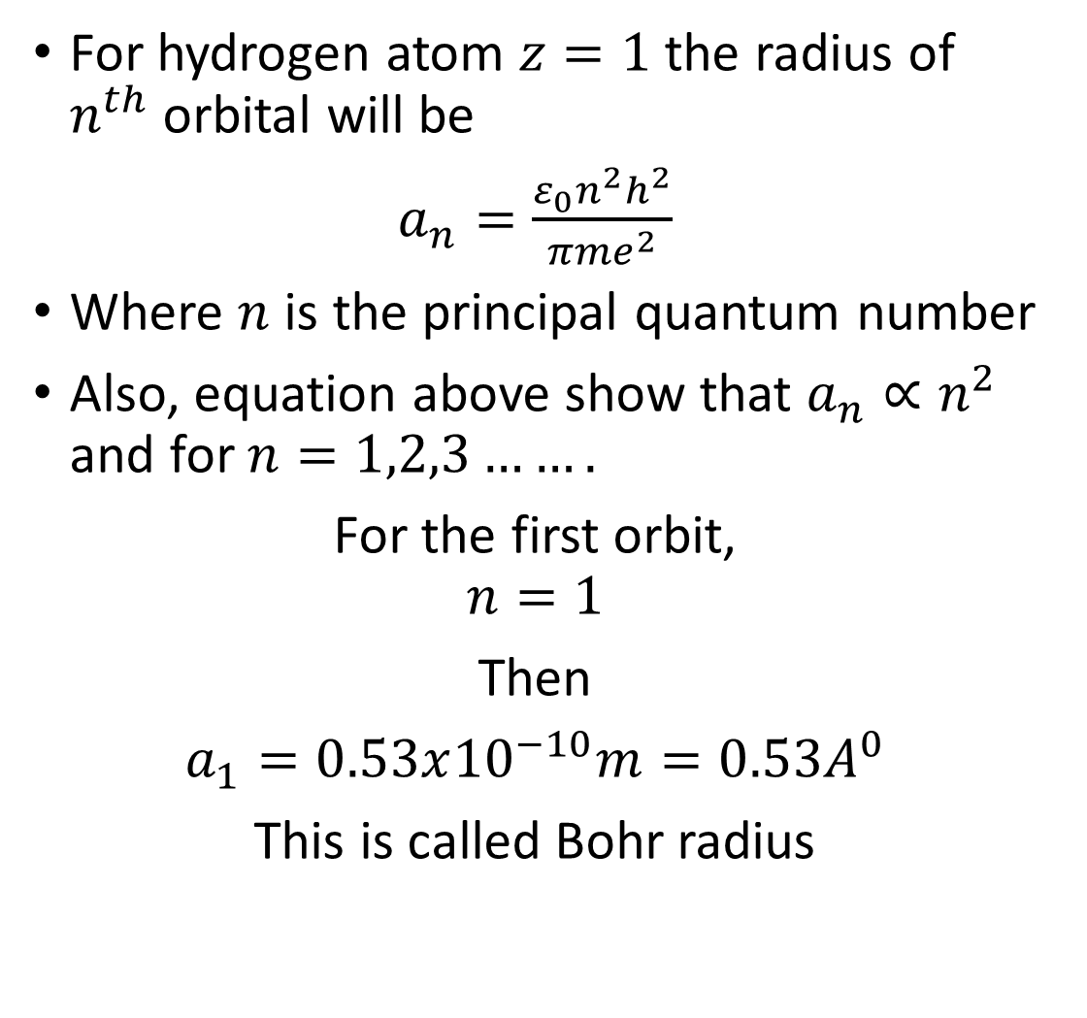
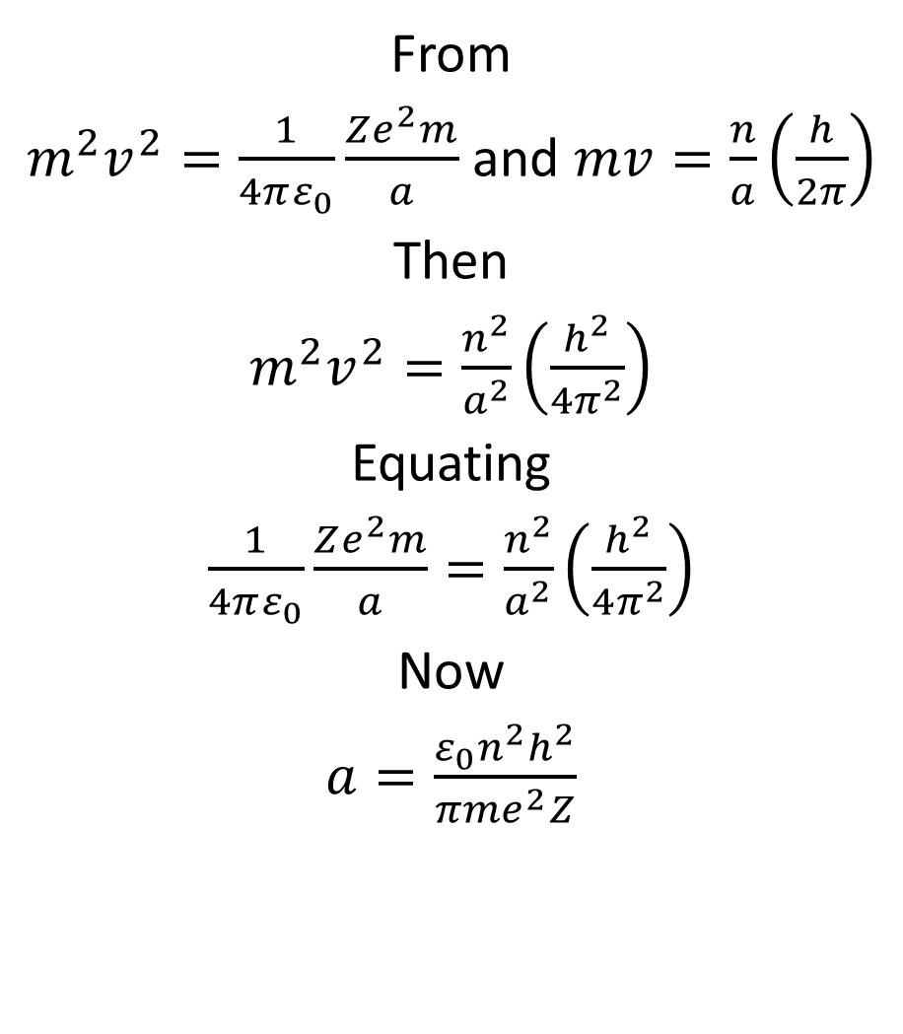
Cont...
From
${m^{2}v}^{2}=\frac{1}{4πε_{0}}\frac{Ze^{2}m}{a}$ and $mv=\frac{n}{a}\left(\frac{h}{2π}\right)$
Then
${m^{2}v}^{2}=\frac{n^{2}}{a^{2}}\left(\frac{h^{2}}{4π^{2}}\right)$
Equating
$\frac{1}{4πε_{0}}\frac{Ze^{2}m}{a}=\frac{n^{2}}{a^{2}}\left(\frac{h^{2}}{4π^{2}}\right)$
Now
$a=\frac{ε_{0}n^{2}h^{2}}{{πme}^{2}Z}$
For hydrogen atom $z=1$ the radius of $n^{th}$ orbital will be
$a_{n}=\frac{ε_{0}n^{2}h^{2}}{{πme}^{2}}$
Where $n$ is the principal quantum number
Also, equation above show that $a_{n}∝n^{2}$ and for $n=1,2,3…….$
For the first orbit,
$$n=1$$
Then
$a_{1}=0.53x{10}^{−10}m=0.53A^{0}$
This is called Bohr radius

Slide 17
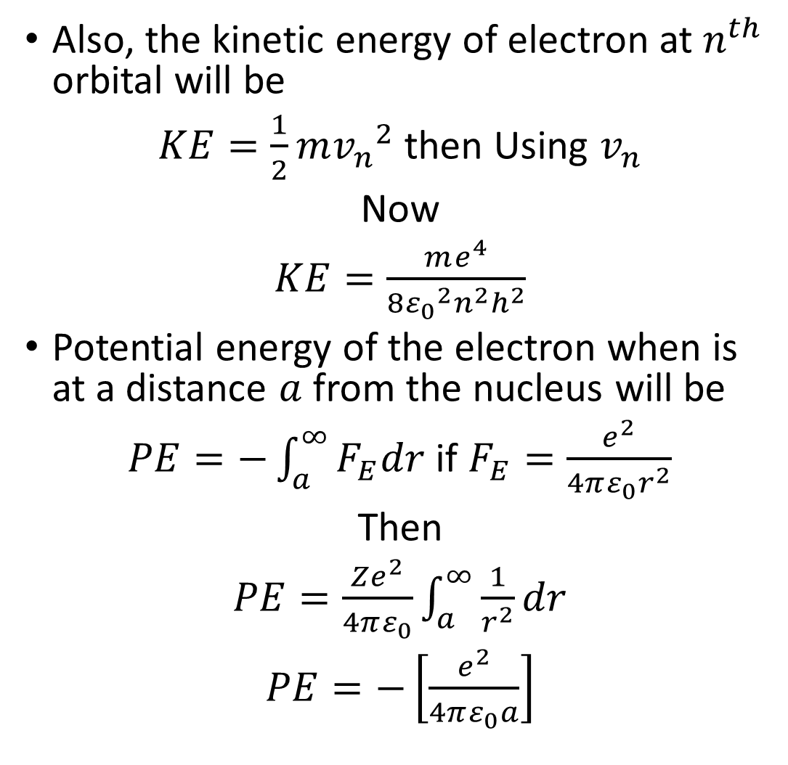
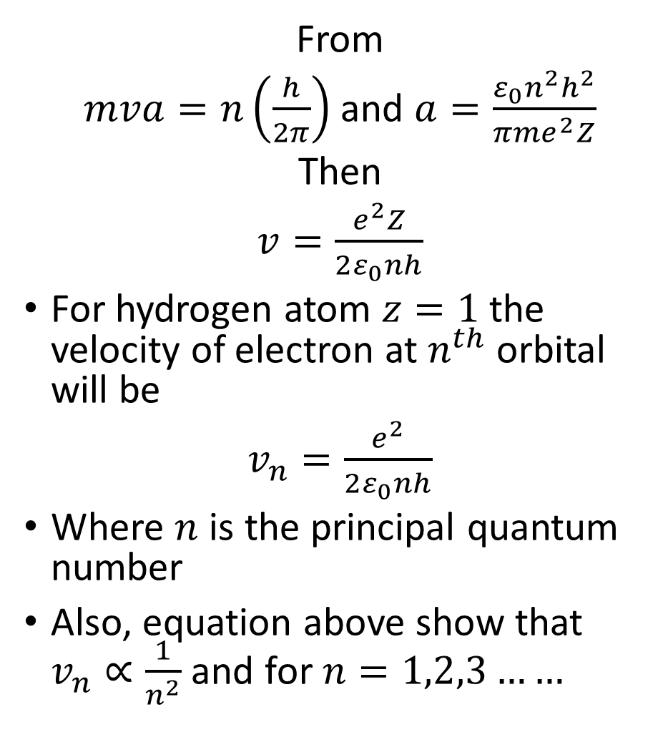
Cont...
From
$mva=n\left(\frac{h}{2π}\right)$ and $a=\frac{ε_{0}n^{2}h^{2}}{{πme}^{2}Z}$
Then
$v=\frac{e^{2}Z}{2ε_{0}nh}$
For hydrogen atom $z=1$ the velocity of electron at $n^{th}$ orbital will be
$v_{n}=\frac{e^{2}}{2ε_{0}nh}$
Where $n$ is the principal quantum number
Also, equation above show that $v_{n}∝\frac{1}{n^{2}}$ and for $n=1,2,3……$
Also, the kinetic energy of electron at $n^{th}$ orbital will be
$KE=\frac{1}{2}m{v_{n}}^{2}$ then Using $v_{n}$
Now
$KE=\frac{me^{4}}{8{ε_{0}}^{2}n^{2}h^{2}}$
Potential energy of the electron when is at a distance $a$ from the nucleus will be
$PE=−\int_{a}^{∞}{F_{E}dr}$ if $F_{E}=\frac{e^{2}}{4πε_{0}r^{2}}$
Then
$PE=\frac{Ze^{2}}{4πε_{0}}\int_{a}^{∞}{\frac{1}{r^{2}}dr}$
$PE=−\left[\frac{e^{2}}{4πε_{0}a}\right]$

Slide 18
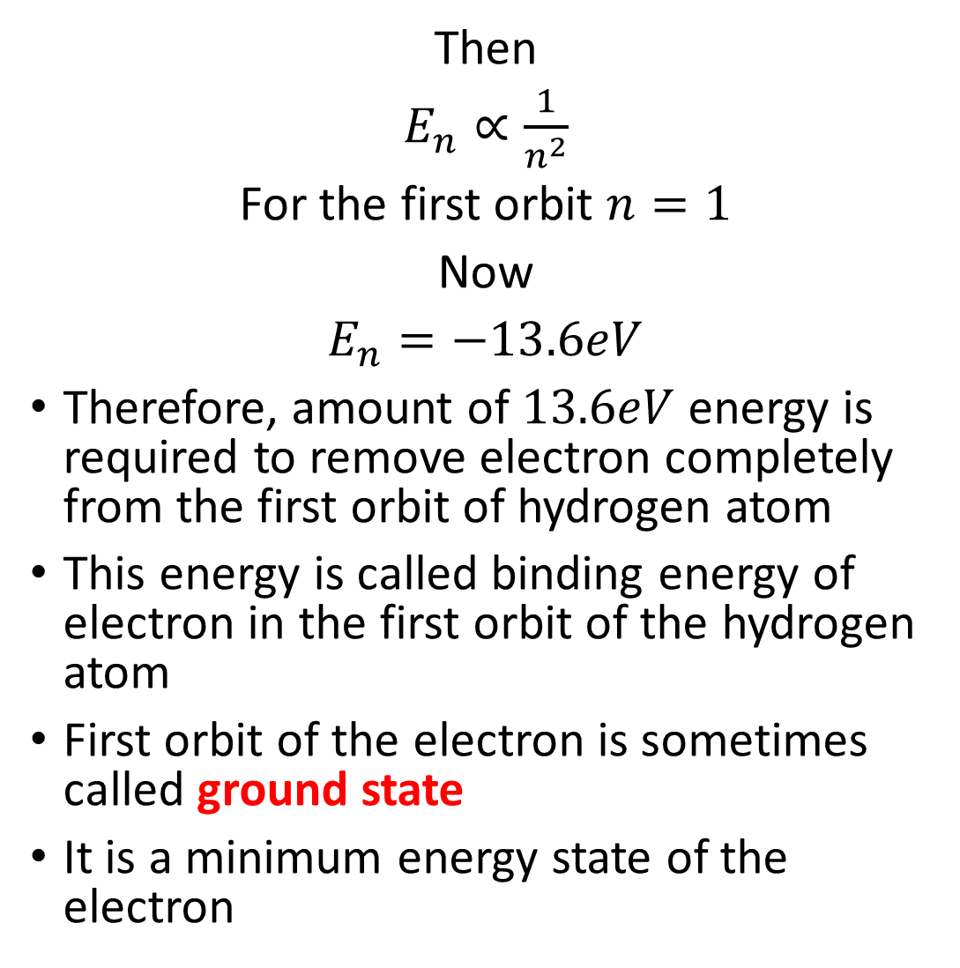
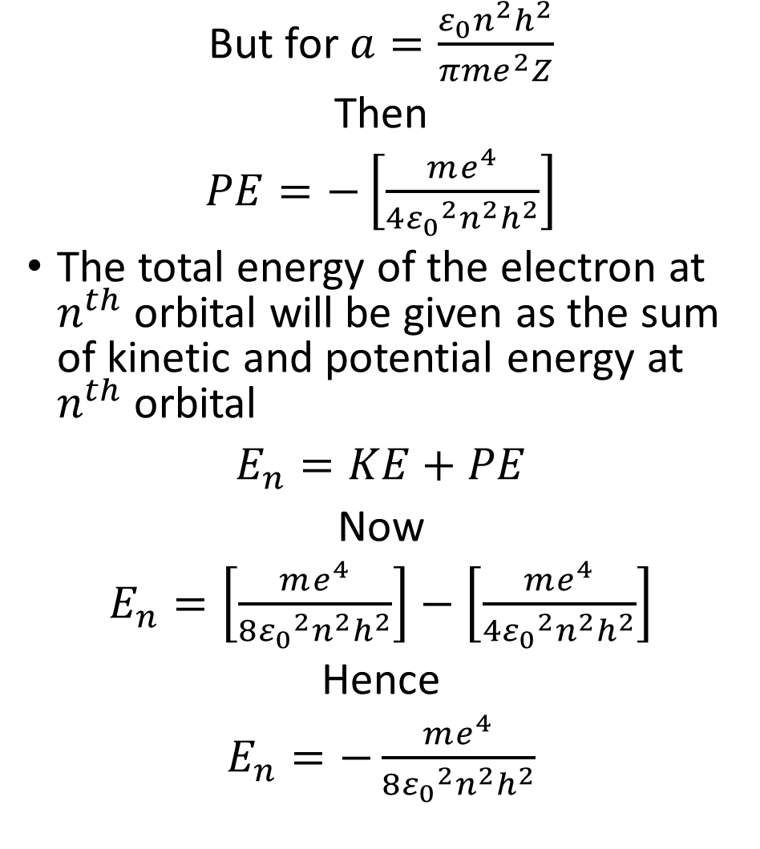
Cont...
But for $a=\frac{ε_{0}n^{2}h^{2}}{{πme}^{2}Z}$
Then
$PE=−\left[\frac{me^{4}}{4{ε_{0}}^{2}n^{2}h^{2}}\right]$
The total energy of the electron at $n^{th}$ orbital will be given as the sum of kinetic and potential energy at $n^{th}$ orbital
$E_{n}=KE+PE$
Now
$E_{n}=\left[\frac{me^{4}}{8{ε_{0}}^{2}n^{2}h^{2}}\right]−\left[\frac{me^{4}}{4{ε_{0}}^{2}n^{2}h^{2}}\right]$
Hence
$E_{n}=−\frac{me^{4}}{8{ε_{0}}^{2}n^{2}h^{2}}$
Then
$E_{n}∝\frac{1}{n^{2}}$
For the first orbit $n=1$
Now
$E_{n}=−13.6eV$
Therefore, amount of $13.6eV$ energy is required to remove electron completely from the first orbit of hydrogen atom
This energy is called binding energy of electron in the first orbit of the hydrogen atom
First orbit of the electron is sometimes called ground state
It is a minimum energy state of the electron

Slide 19
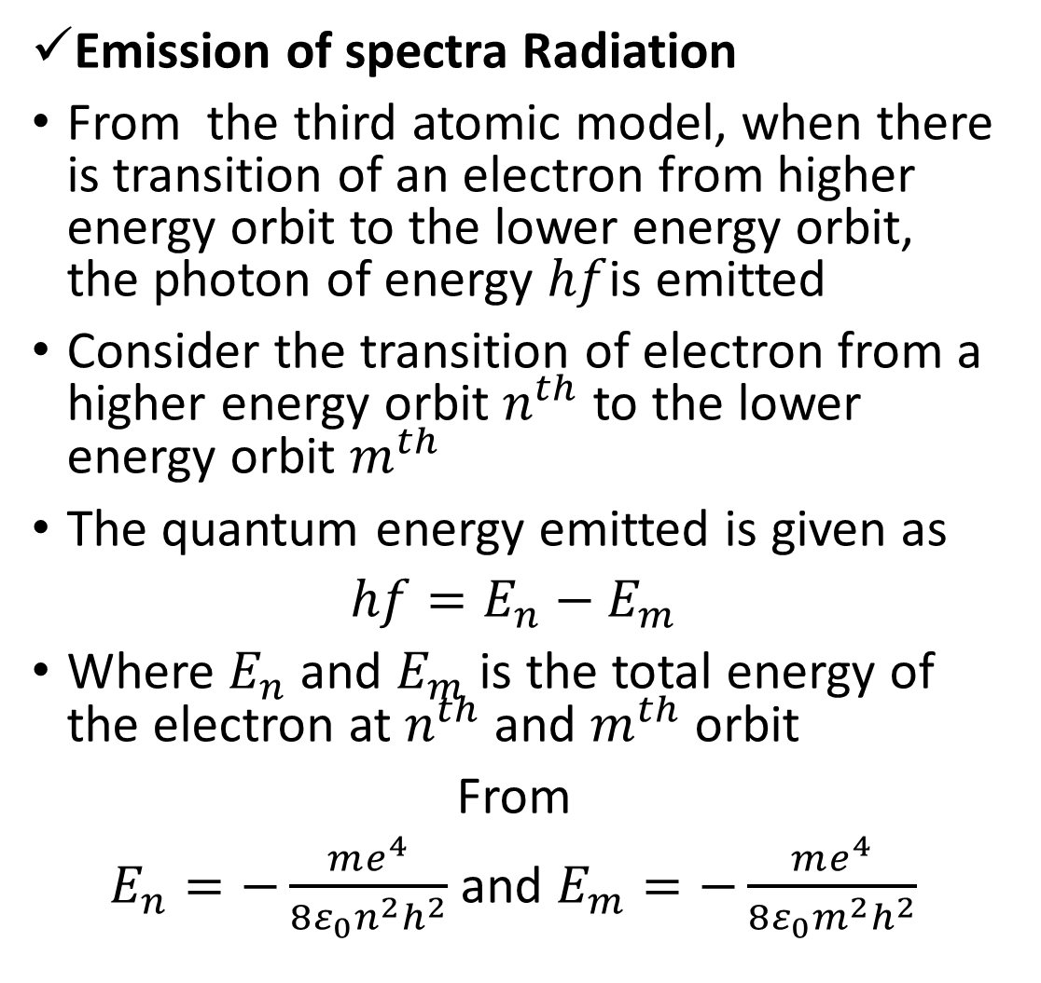
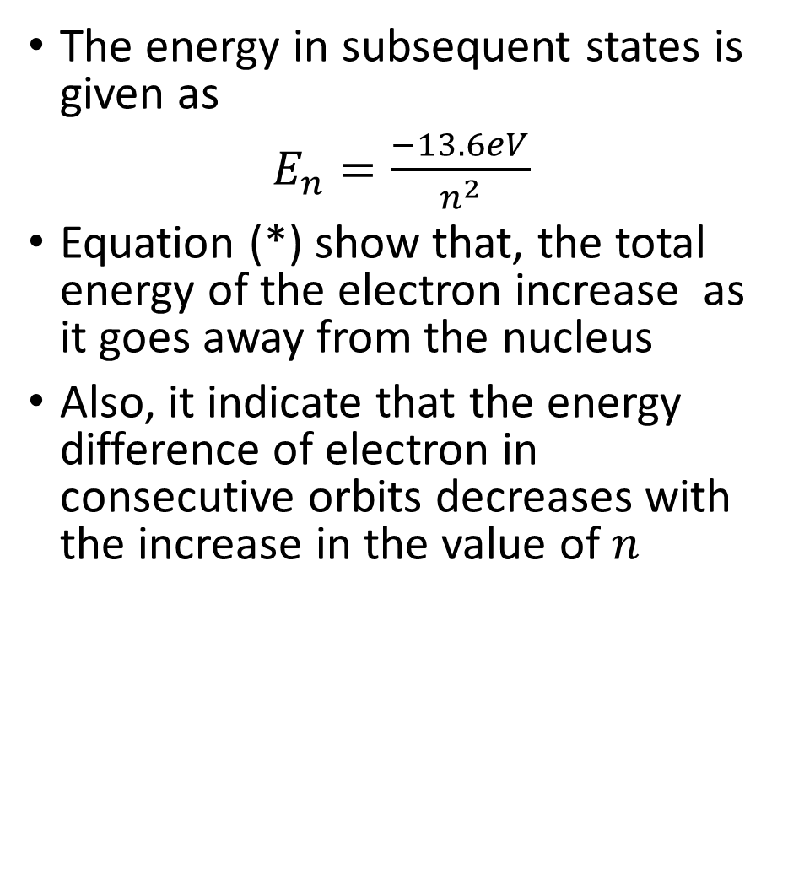
Cont...
The energy in subsequent states is given as
$E_{n}=\frac{−13.6eV}{n^{2}}$
Equation (*) show that, the total energy of the electron increase as it goes away from the nucleus
Also, it indicate that the energy difference of electron in consecutive orbits decreases with the increase in the value of $n$
Emission of spectra Radiation
From the third atomic model, when there is transition of an electron from higher energy orbit to the lower energy orbit, the photon of energy $hf$is emitted
Consider the transition of electron from a higher energy orbit $n^{th}$ to the lower energy orbit $m^{th}$
The quantum energy emitted is given as
$hf=E_{n}−E_{m}$
Where $E_{n}$ and $E_{m}$ is the total energy of the electron at $n^{th}$ and $m^{th}$ orbit
From
$E_{n}=−\frac{me^{4}}{8ε_{0}n^{2}h^{2}}$ and $E_{m}=−\frac{me^{4}}{8ε_{0}m^{2}h^{2}}$

Slide 20
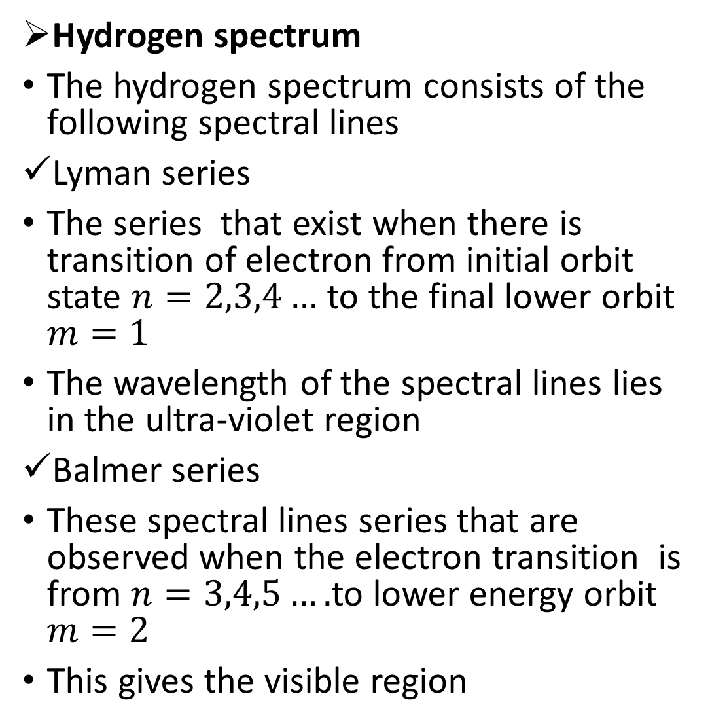
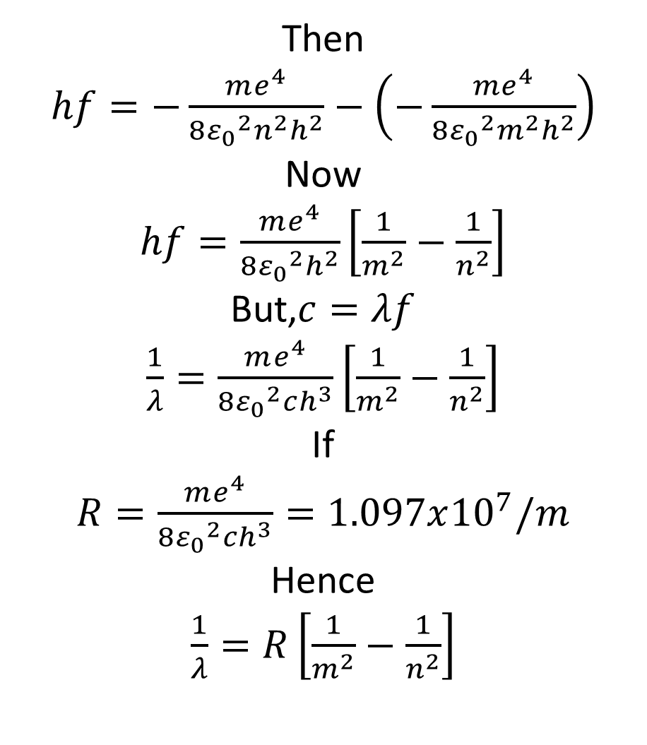
Cont...
Hydrogen spectrum
The hydrogen spectrum consists of the following spectral lines
Lyman series
The series that exist when there is transition of electron from initial orbit state $n=2,3,4…$ to the final lower orbit $m=1$
The wavelength of the spectral lines lies in the ultra-violet region
Balmer series
These spectral lines series that are observed when the electron transition is from $n=3,4,5….$to lower energy orbit $m=2$
This gives the visible region
Then
$hf=−\frac{me^{4}}{8{ε_{0}}^{2}n^{2}h^{2}}−\left(−\frac{me^{4}}{8{ε_{0}}^{2}m^{2}h^{2}}\right)$
Now
$hf=\frac{me^{4}}{8{ε_{0}}^{2}h^{2}}\left[\frac{1}{m^{2}}−\frac{1}{n^{2}}\right]$
But,$c=λf$
$\frac{1}{λ}=\frac{me^{4}}{8{ε_{0}}^{2}ch^{3}}\left[\frac{1}{m^{2}}−\frac{1}{n^{2}}\right]$
If
$R=\frac{me^{4}}{8{ε_{0}}^{2}ch^{3}}=1.097x{10}^{7}/m$
Hence
$\frac{1}{λ}=R\left[\frac{1}{m^{2}}−\frac{1}{n^{2}}\right]$

Slide 21
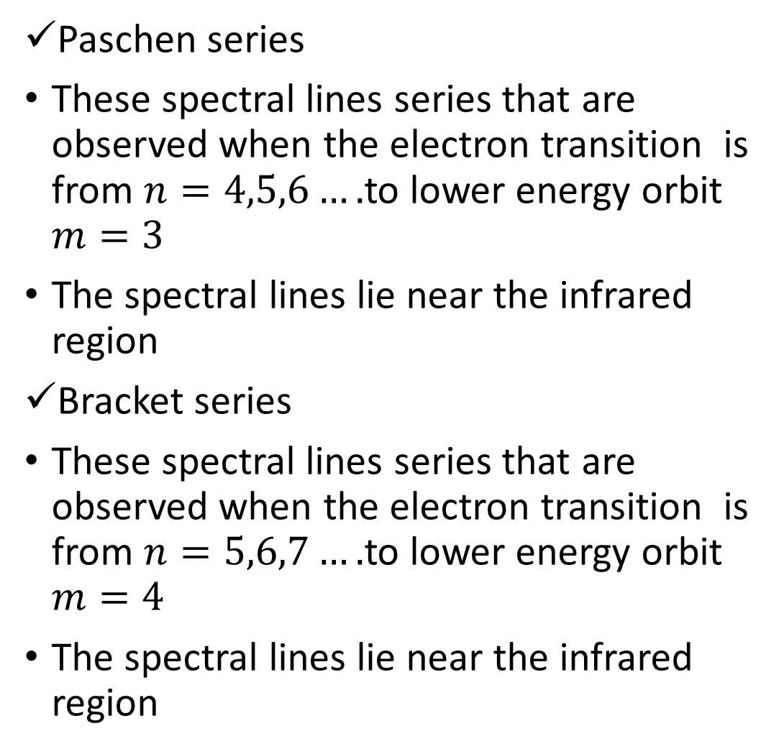
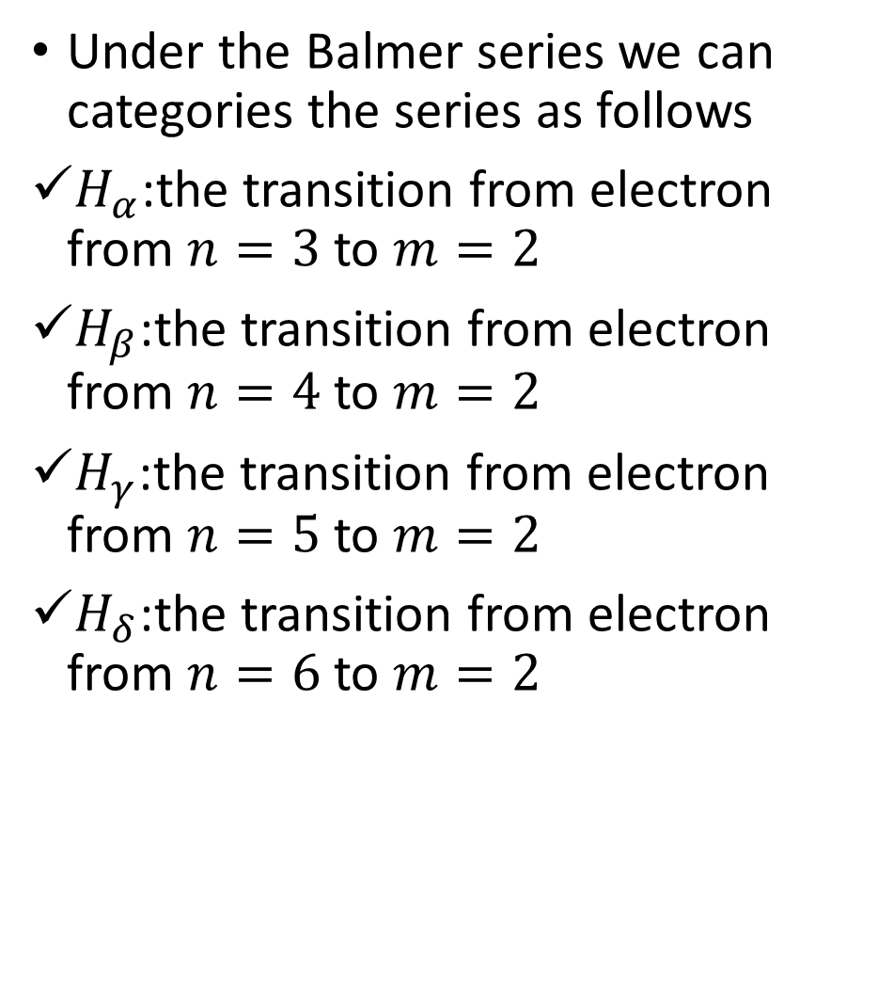
Cont...
Under the Balmer series we can categories the series as follows
$H_{α}$:the transition from electron from $n=3$ to $m=2$
$H_{β}$:the transition from electron from $n=4$ to $m=2$
$H_{γ}$:the transition from electron from $n=5$ to $m=2$
$H_{δ}$:the transition from electron from $n=6$ to $m=2$
Paschen series
These spectral lines series that are observed when the electron transition is from $n=4,5,6….$to lower energy orbit $m=3$
The spectral lines lie near the infrared region
Bracket series
These spectral lines series that are observed when the electron transition is from $n=5,6,7….$to lower energy orbit $m=4$
The spectral lines lie near the infrared region

Slide 22
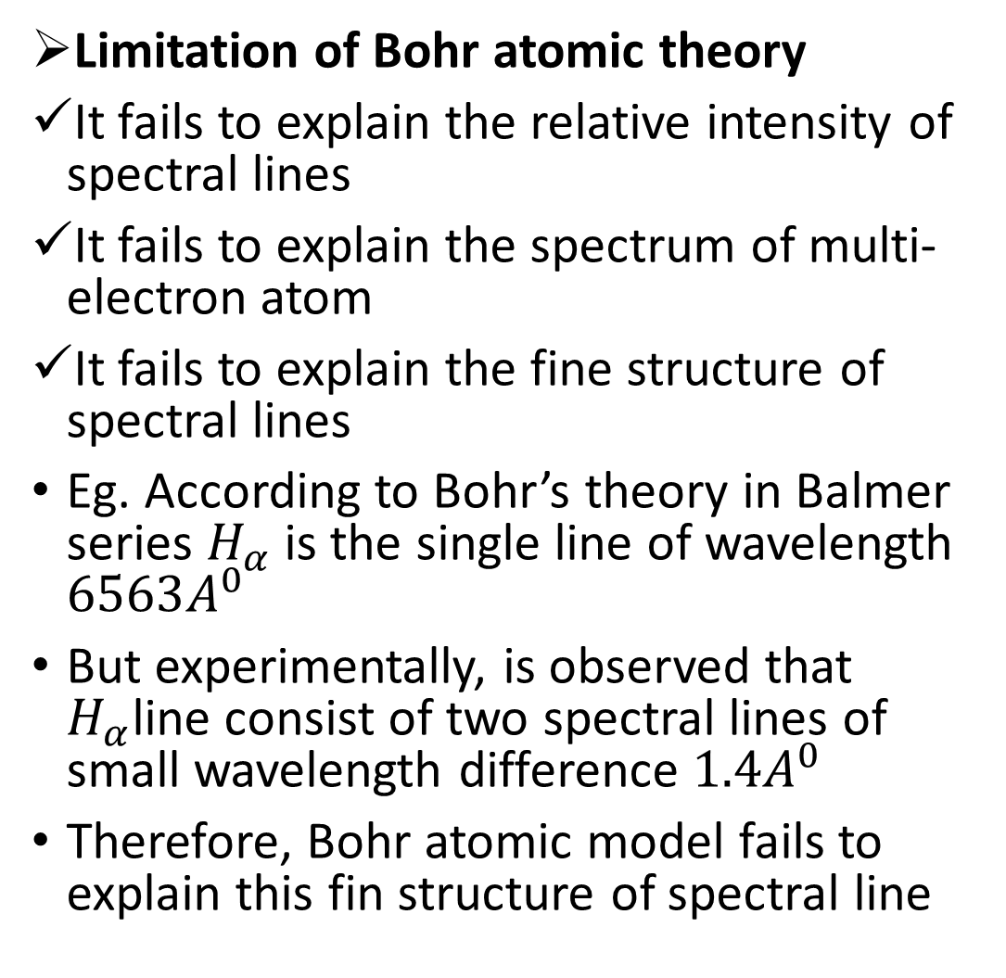
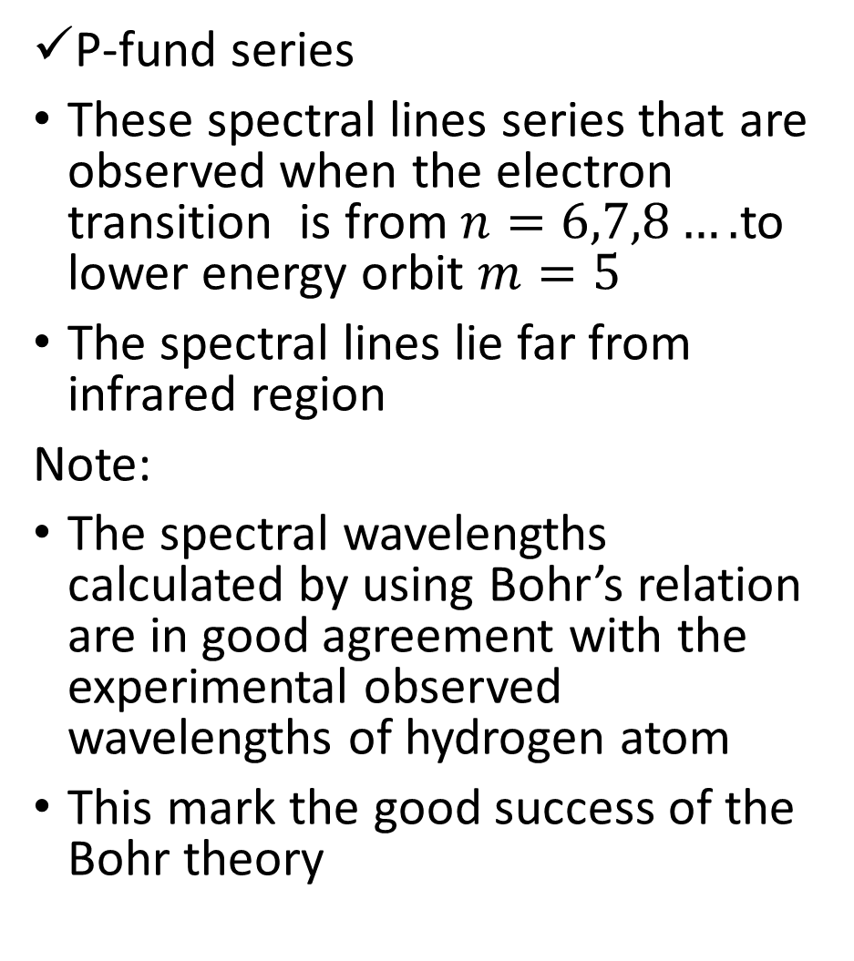
Cont...
P-fund series
These spectral lines series that are observed when the electron transition is from $n=6,7,8….$to lower energy orbit $m=5$
The spectral lines lie far from infrared region
Note:
The spectral wavelengths calculated by using Bohr’s relation are in good agreement with the experimental observed wavelengths of hydrogen atom
This mark the good success of the Bohr theory
Limitation of Bohr atomic theory
It fails to explain the relative intensity of spectral lines
It fails to explain the spectrum of multi-electron atom
It fails to explain the fine structure of spectral lines
Eg. According to Bohr’s theory in Balmer series $H_{α}$ is the single line of wavelength $6563A^{0}$
But experimentally, is observed that $H_{α}$line consist of two spectral lines of small wavelength difference $1.4A^{0}$
Therefore, Bohr atomic model fails to explain this fin structure of spectral line

Slide 23
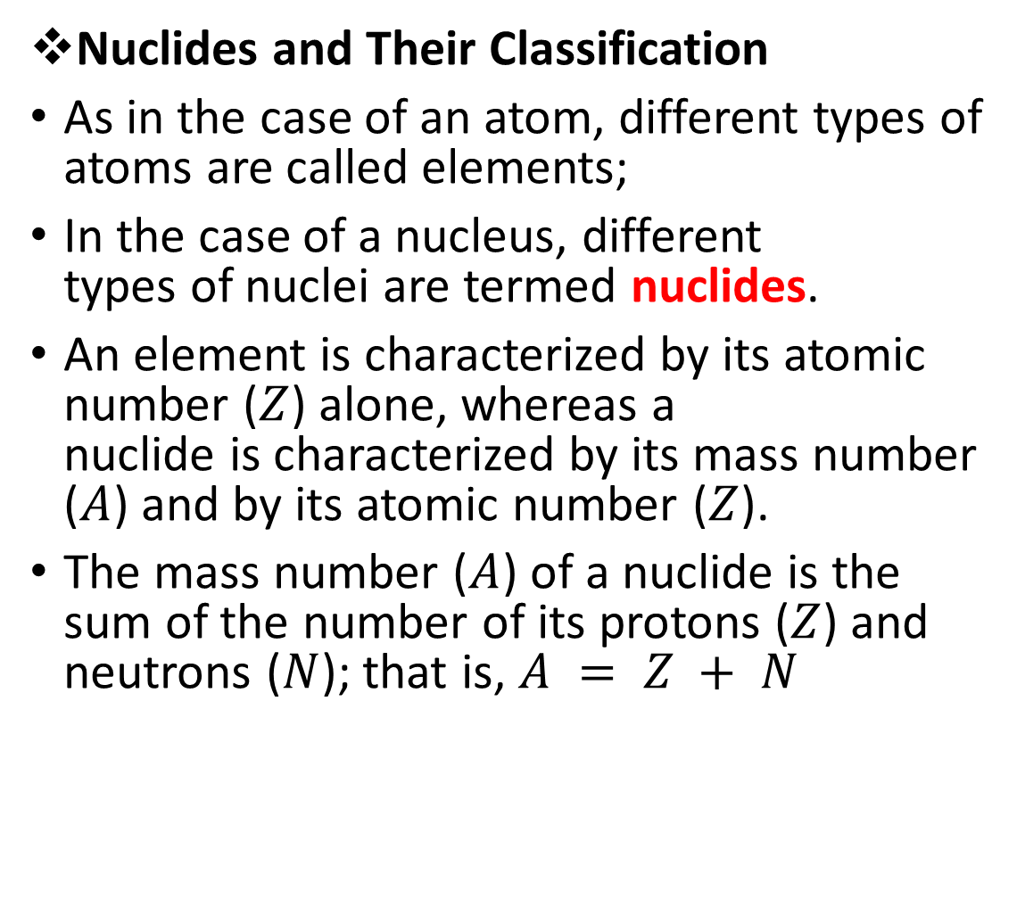
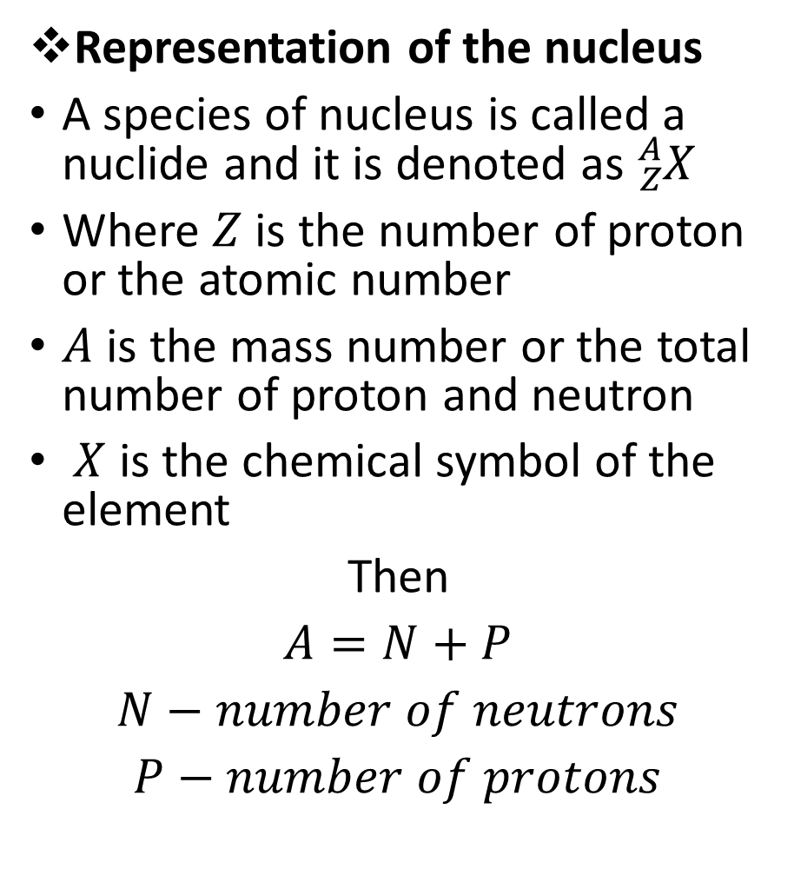
Cont...
Representation of the nucleus
A species of nucleus is called a nuclide and it is denoted as ${}_{Z}^{A}X$
Where $Z$ is the number of proton or the atomic number
$A$ is the mass number or the total number of proton and neutron
$X$ is the chemical symbol of the element
Then
$A=N+P$
$N−number of neutrons$
$P−number of protons$
Nuclides and Their Classification
As in the case of an atom, different types of atoms are called elements;
In the case of a nucleus, different types of nuclei are termed nuclides.
An element is characterized by its atomic number ($Z$) alone, whereas a nuclide is characterized by its mass number ($A$) and by its atomic number ($Z$).
The mass number ($A$) of a nuclide is the sum of the number of its protons ($Z$) and neutrons ($N$); that is, $A = Z + N$

Slide 24

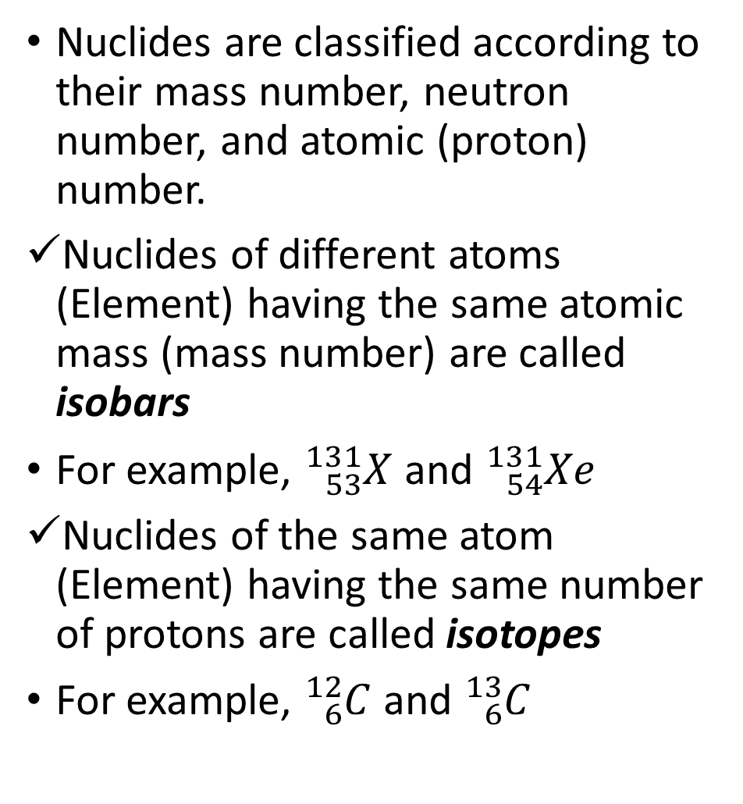
Cont...
Nuclides are classified according to their mass number, neutron number, and atomic (proton) number.
Nuclides of different atoms (Element) having the same atomic mass (mass number) are called isobars
For example, ${}_{53}^{131}X$ and ${}_{54}^{131}{Xe}$
Nuclides of the same atom (Element) having the same number of protons are called isotopes
For example, ${}_{6}^{12}C$ and ${}_{6}^{13}C$
Nuclides of different atoms (Element) having the same number of neutrons are called isotones
For example, ${}_{7}^{13}N$ and ${}_{8}^{14}O$

Slide 25

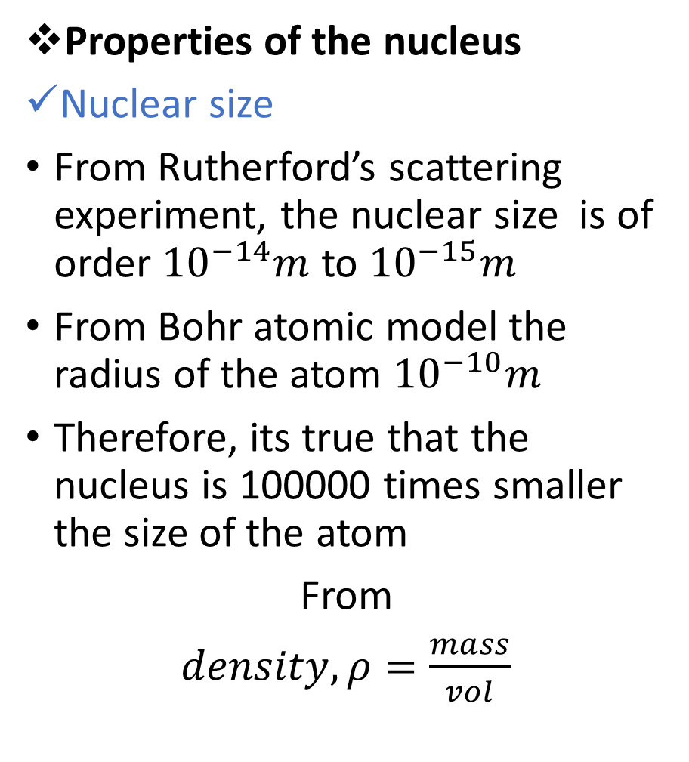
Cont...
Properties of the nucleus
Nuclear size
From Rutherford’s scattering experiment, the nuclear size is of order ${10}^{−14}m$ to ${10}^{−15}m$
From Bohr atomic model the radius of the atom ${10}^{−10}m$
Therefore, its true that the nucleus is 100000 times smaller the size of the atom
From
$density,ρ=\frac{mass}{vol}$
If
$$Zm_{p}+Nm_{n}=m$$
$vol=\frac{4}{3}πR^{3}$
But
$m_{p}≈m_{n}=m_{n}$
Now
$ρ=\frac{m_{n}[Z+N]}{\frac{4}{3}πR^{3}}$ where $Z+N=A$
Then
$R^{3}={\left(\frac{3m_{n}}{4πρ}\right)}^{1/3}A^{1/3}$

Slide 26
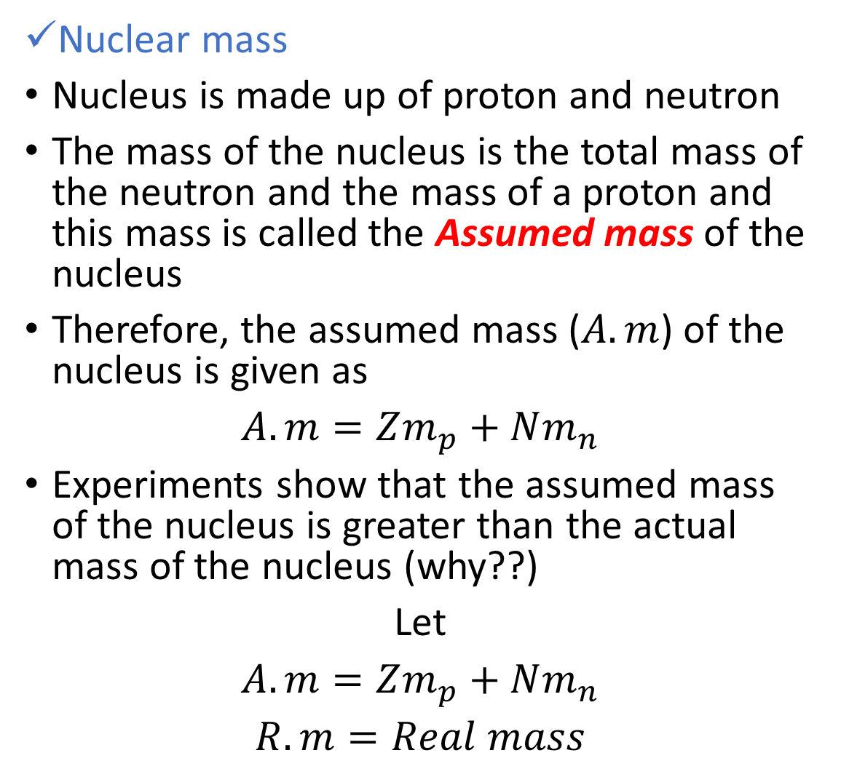

Cont...
Let
${\left(\frac{3m_{n}}{4πρ}\right)}^{1/3}=c=R_{0}$
Where
$$R_{0}=1.3x{10}^{−15}m=1.3fm$$
Then
$R=R_{0}A^{1/3}$
Nuclear mass
Nucleus is made up of proton and neutron
The mass of the nucleus is the total mass of the neutron and the mass of a proton and this mass is called the Assumed mass of the nucleus
Therefore, the assumed mass ($A.m$) of the nucleus is given as
$A.m=Zm_{p}+Nm_{n}$
Experiments show that the assumed mass of the nucleus is greater than the actual mass of the nucleus (why??)
Let
$A.m=Zm_{p}+Nm_{n}$
$R.m=Real mass$

Slide 27
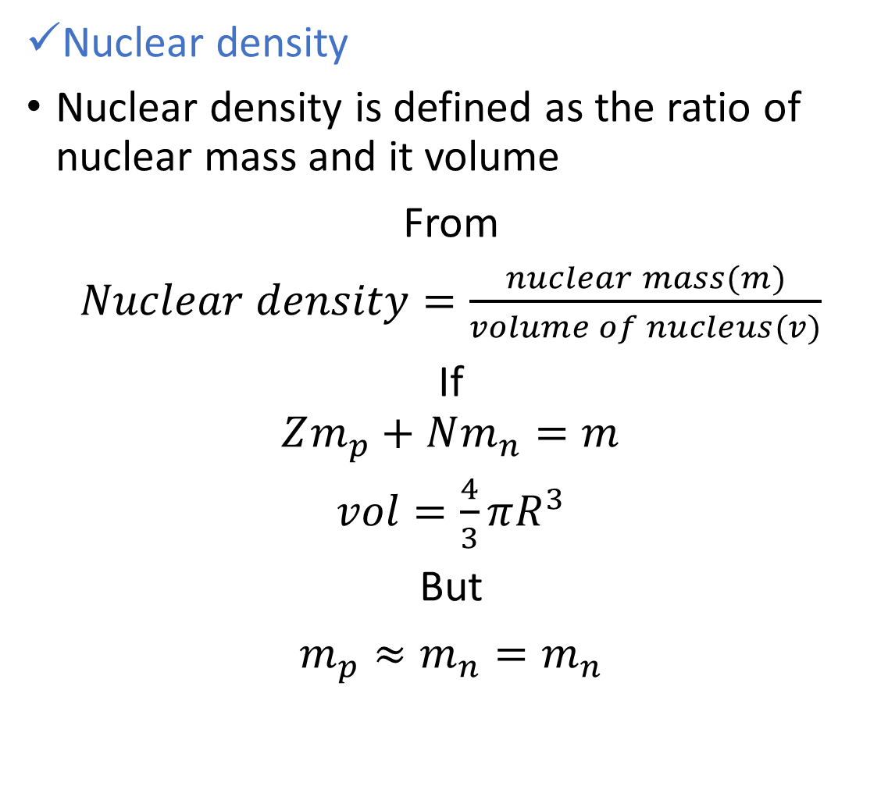
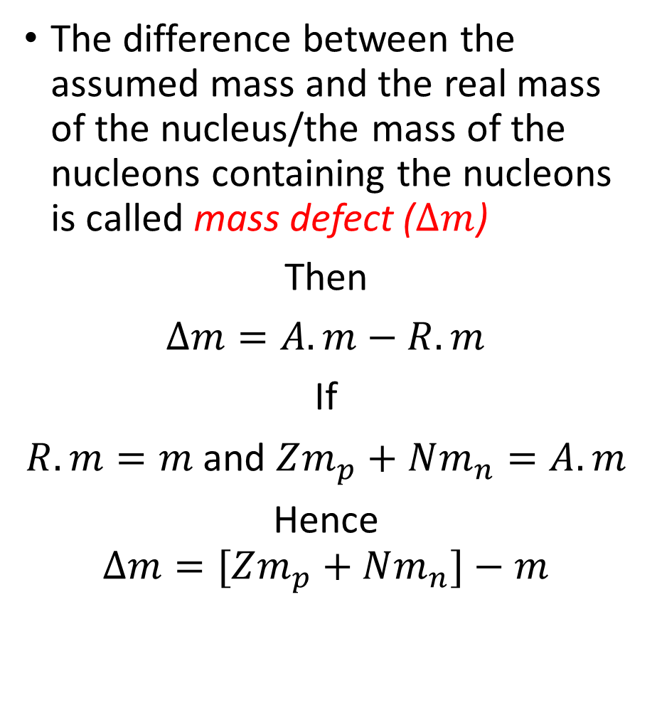
Cont...
The difference between the assumed mass and the real mass of the nucleus/the mass of the nucleons containing the nucleons is called mass defect ($∆m$)
Then
$∆m=A.m−R.m$
If
$R.m=m$ and $Zm_{p}+Nm_{n}=A.m$
Hence
$$∆m=[Zm_{p}+Nm_{n}]−m$$
Nuclear density
Nuclear density is defined as the ratio of nuclear mass and it volume
From
$Nuclear density=\frac{nuclear mass(m)}{volume of nucleus(v)}$
If
$$Zm_{p}+Nm_{n}=m$$
$vol=\frac{4}{3}πR^{3}$
But
$m_{p}≈m_{n}=m_{n}$

Slide 28
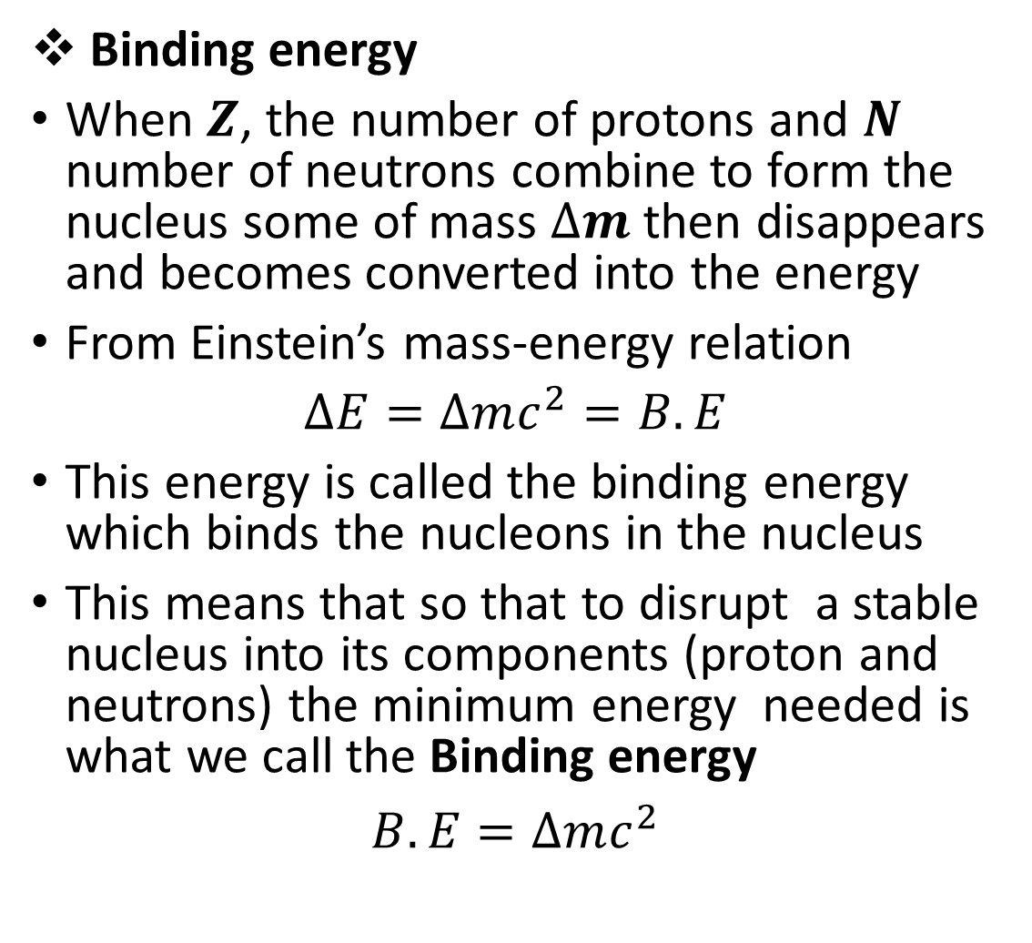
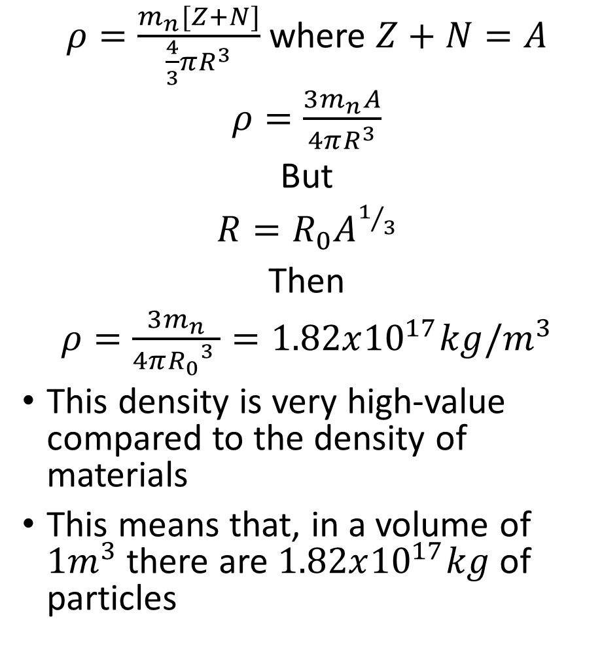
Cont...
$ρ=\frac{m_{n}[Z+N]}{\frac{4}{3}πR^{3}}$ where $Z+N=A$
$ρ=\frac{3m_{n}A}{4πR^{3}}$
But
$R=R_{0}A^{1/3}$
Then
$ρ=\frac{3m_{n}}{4π{R_{0}}^{3} }=1.82x{10}^{17}kg/m^{3}$
This density is very high-value compared to the density of materials
This means that, in a volume of $1m^{3}$ there are $1.82x{10}^{17}kg$ of particles
Binding energy
When $Z$, the number of protons and $N$ number of neutrons combine to form the nucleus some of mass $∆m$ then disappears and becomes converted into the energy
From Einstein’s mass-energy relation
$∆E=∆mc^{2}=B.E$
This energy is called the binding energy which binds the nucleons in the nucleus
This means that so that to disrupt a stable nucleus into its components (proton and neutrons) the minimum energy needed is what we call the Binding energy
$B.E=∆mc^{2}$

Slide 29
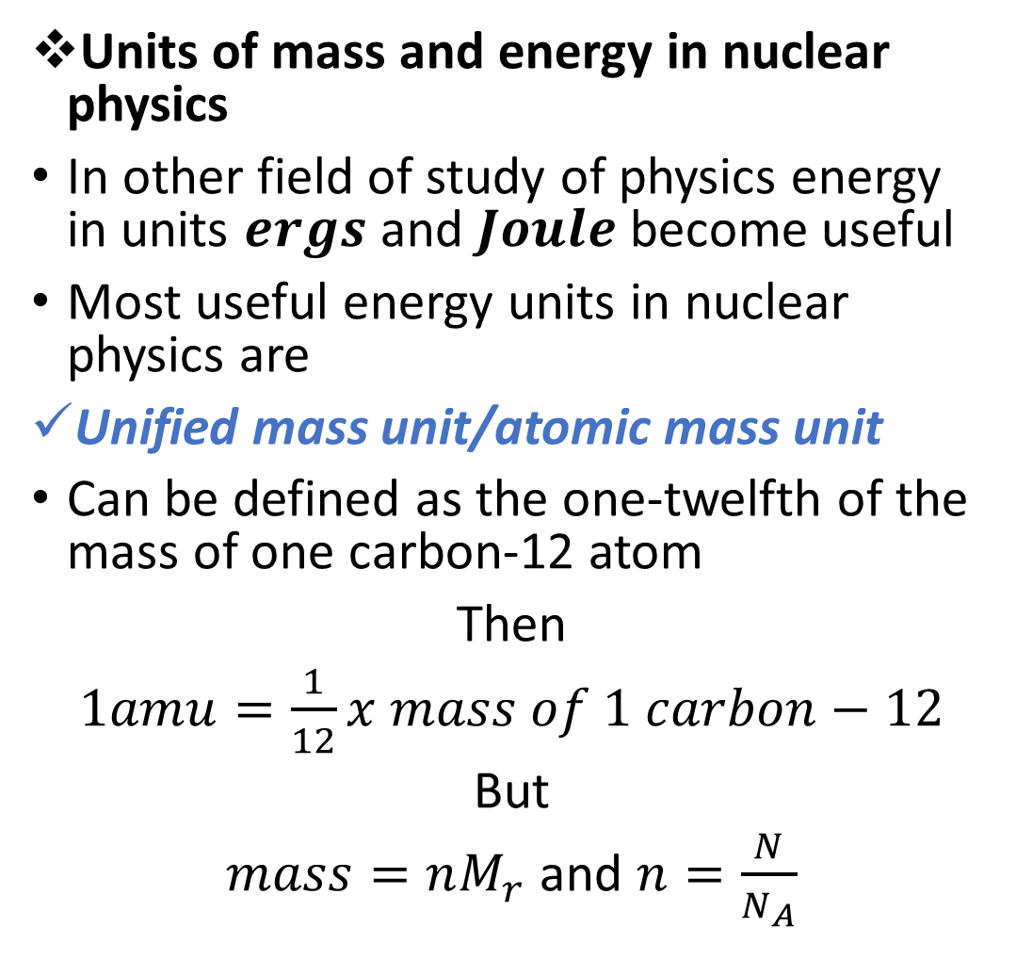
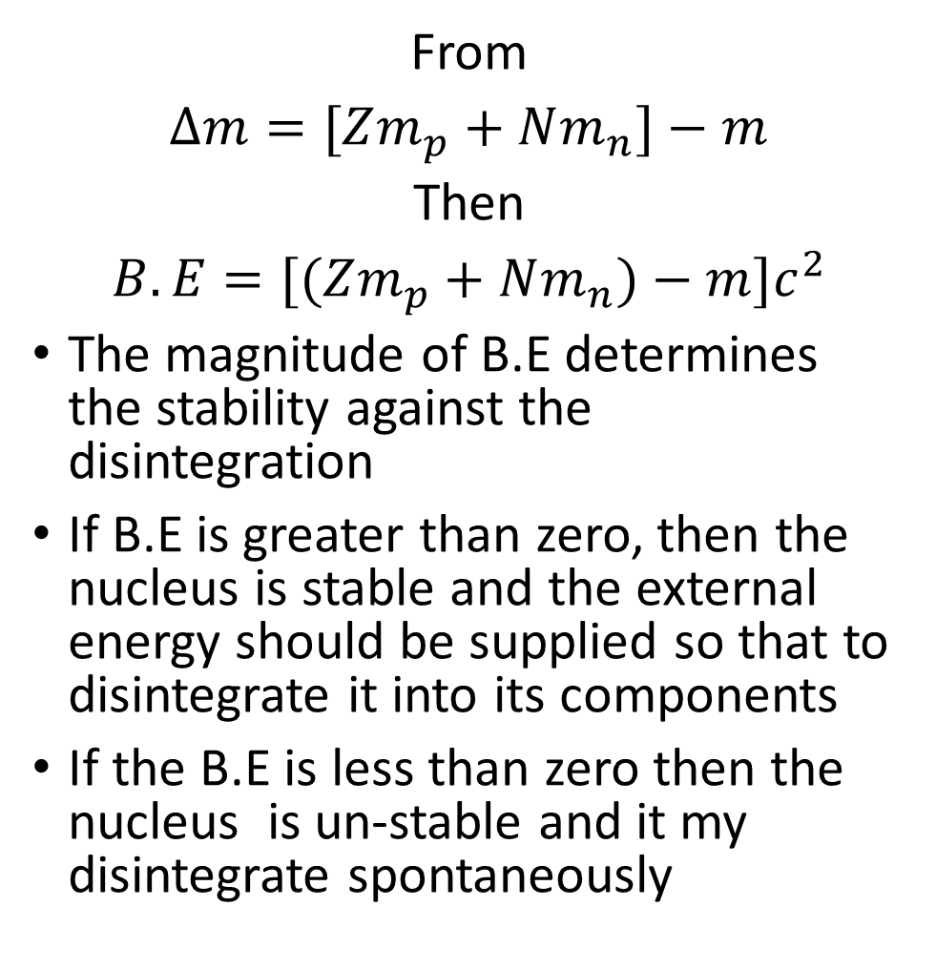
Cont...
From
$∆m=[Zm_{p}+Nm_{n}]−m$
Then
$B.E=[(Zm_{p}+Nm_{n})−m]c^{2}$
The magnitude of B.E determines the stability against the disintegration
If B.E is greater than zero, then the nucleus is stable and the external energy should be supplied so that to disintegrate it into its components
If the B.E is less than zero then the nucleus is un-stable and it my disintegrate spontaneously
Units of mass and energy in nuclear physics
In other field of study of physics energy in units $ergs$ and $Joule$ become useful
Most useful energy units in nuclear physics are
Unified mass unit/atomic mass unit
Can be defined as the one-twelfth of the mass of one carbon-12 atom
Then
$1amu=\frac{1}{12}x mass of 1 carbon−12$
But
$mass=nM_{r}$ and $n=\frac{N}{N_{A}}$

Slide 30
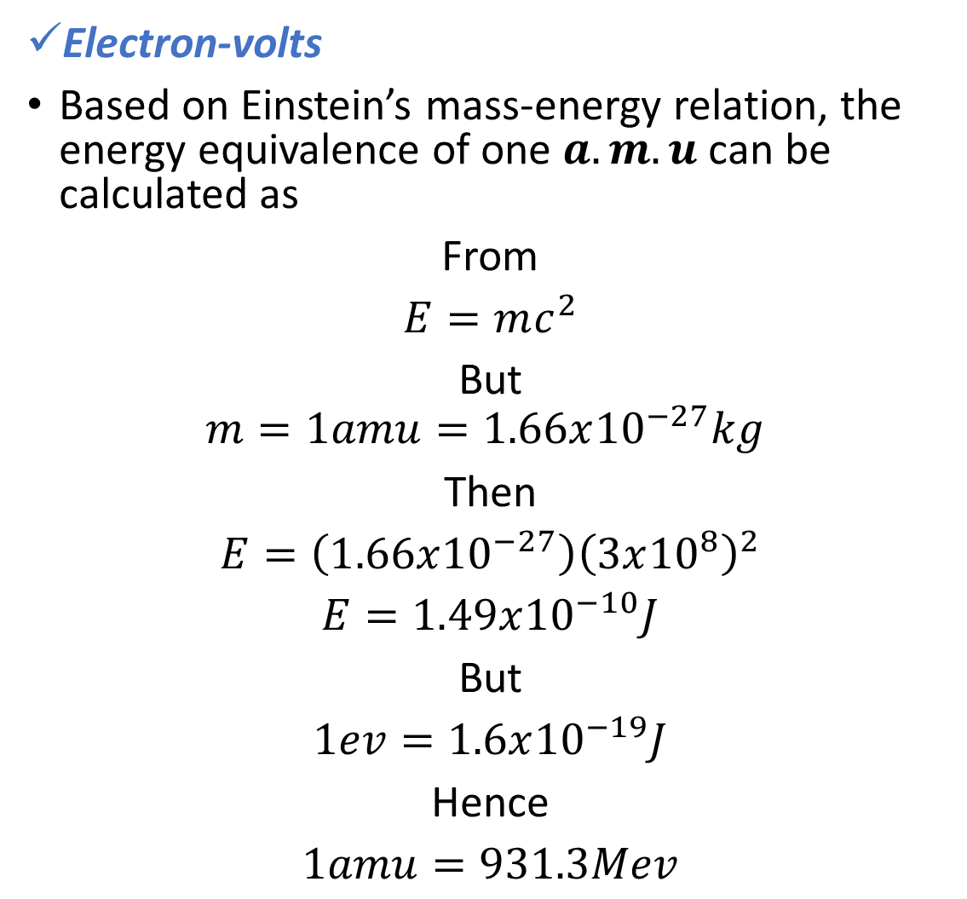
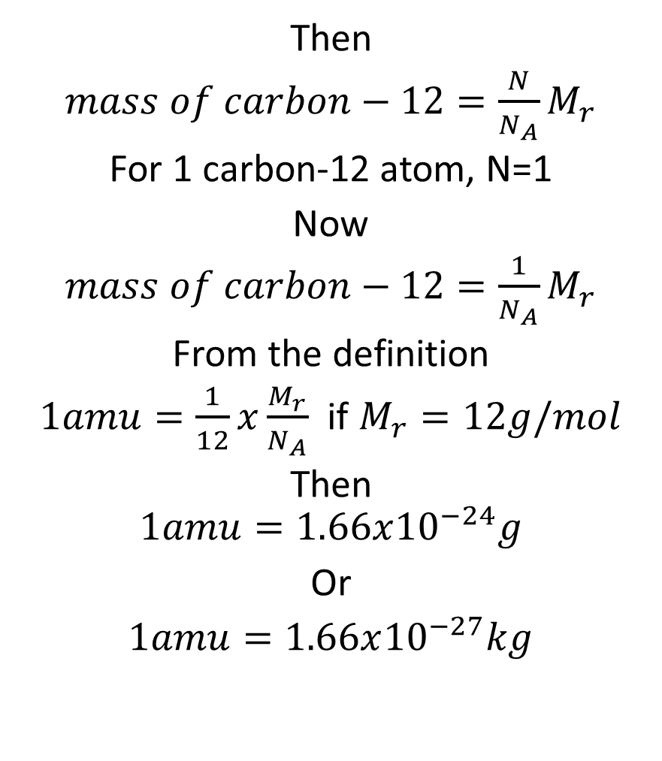
Cont...
Then
$mass of carbon−12=\frac{N}{N_{A}}M_{r}$
For 1 carbon-12 atom, N=1
Now
$mass of carbon−12=\frac{1}{N_{A}}M_{r}$
From the definition
$1amu=\frac{1}{12}x\frac{M_{r}}{N_{A}}$ if $M_{r}=12g/mol$
Then
$$1amu=1.66x{10}^{−24}g$$
Or
$1amu=1.66x{10}^{−27}kg$
Electron-volts
Based on Einstein’s mass-energy relation, the energy equivalence of one $a.m.u$can be calculated as
From
$E=mc^{2}$
But
$$m=1amu=1.66x{10}^{−27}kg$$
Then
$E=\left(1.66x{10}^{−27}\right){\left(3x{10}^{8}\right)}^{2}$
$E=1.49x{10}^{−10}J$
But
$1ev=1.6x{10}^{−19}J$
Hence
$1amu=931.3Mev$

Slide 31
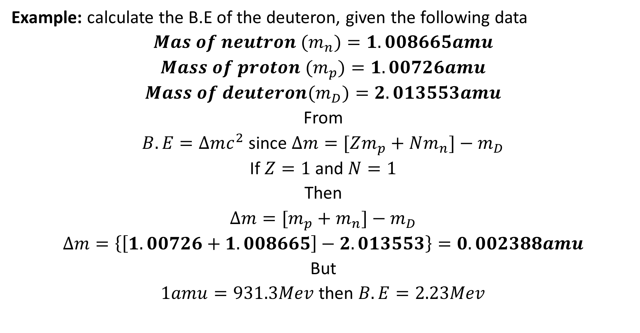
Cont...
Example: calculate the B.E of the deuteron, given the following data
$Mas of neutron (m_{n})=1.008665amu$
$Mass of proton (m_{p})=1.00726amu$
$Mass of deuteron(m_{D})=2.013553amu$
From
$B.E=∆mc^{2}$ since $∆m=[Zm_{p}+Nm_{n}]−m_{D}$
If $Z=1$ and $N=1$
Then
$∆m=[m_{p}+m_{n}]−m_{D}$
$∆m=\left\{\left[1.00726+1.008665\right]−2.013553\right\}=0.002388amu$
But
$1amu=931.3Mev$ then $B.E=2.23Mev$

Slide 32
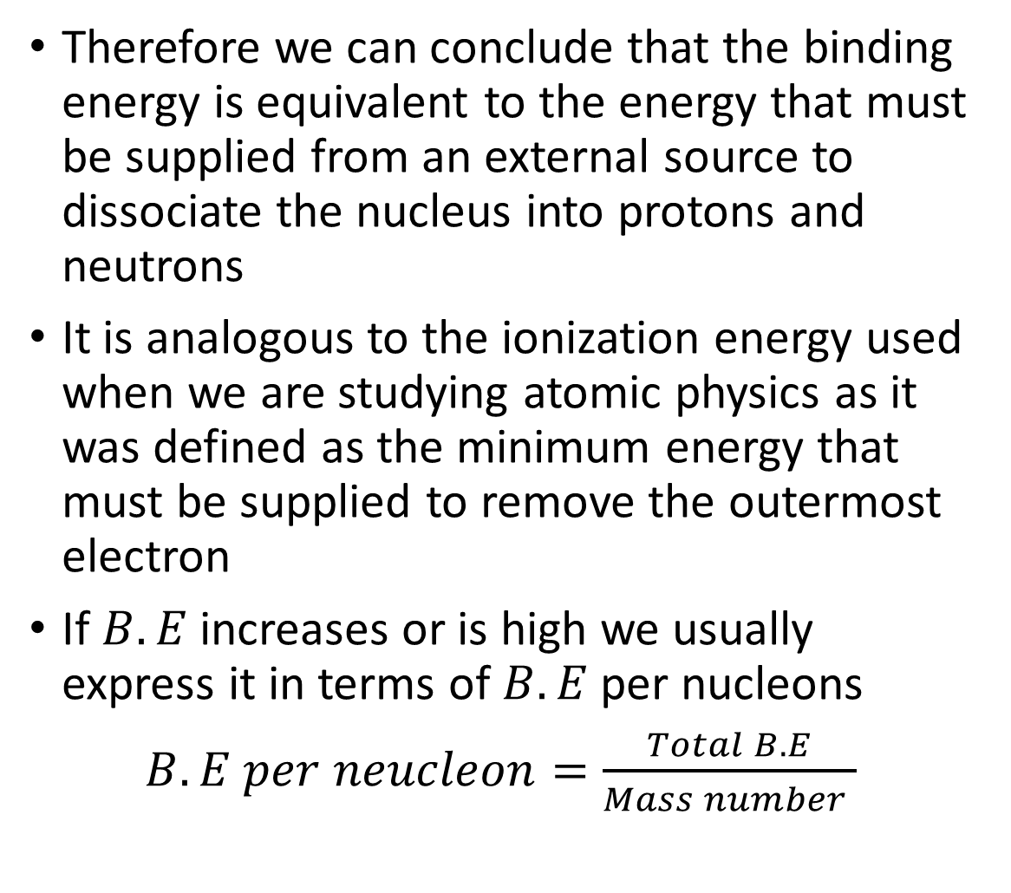
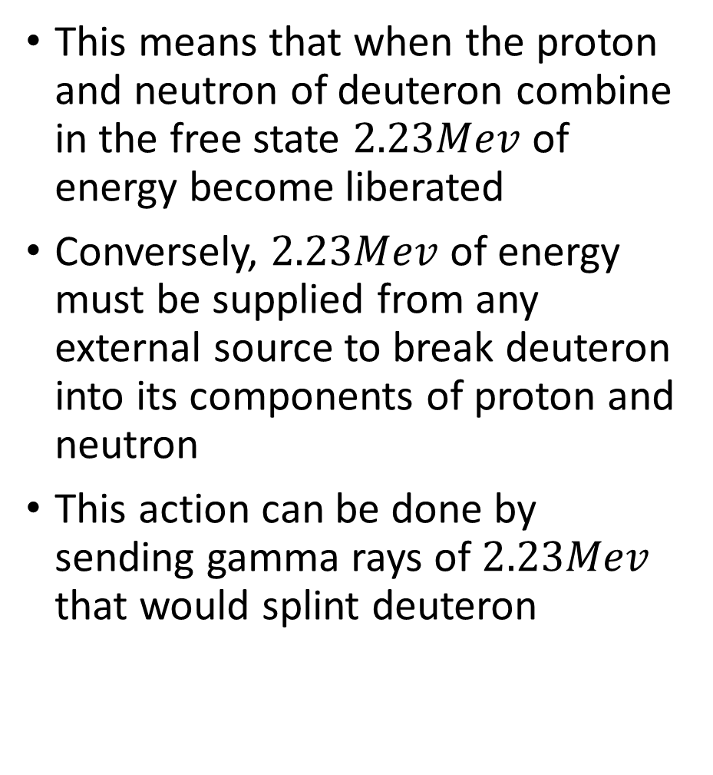
Cont...
This means that when the proton and neutron of deuteron combine in the free state $2.23Mev$ of energy become liberated
Conversely, $2.23Mev$ of energy must be supplied from any external source to break deuteron into its components of proton and neutron
This action can be done by sending gamma rays of $2.23Mev$ that would splint deuteron
Therefore we can conclude that the binding energy is equivalent to the energy that must be supplied from an external source to dissociate the nucleus into protons and neutrons
It is analogous to the ionization energy used when we are studying atomic physics as it was defined as the minimum energy that must be supplied to remove the outermost electron
If $B.E$ increases or is high we usually express it in terms of $B.E$ per nucleons
$B.E per neucleon=\frac{Total B.E}{Mass number }$

Slide 33
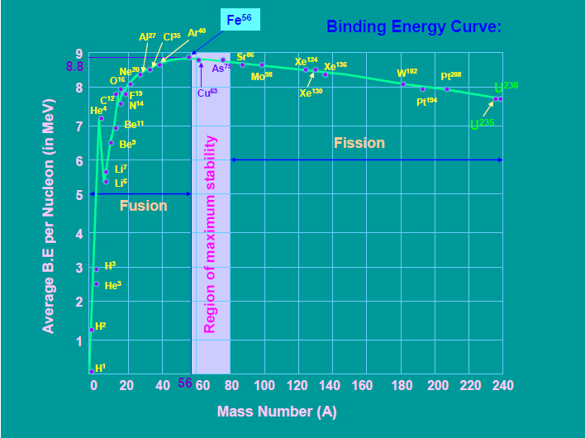
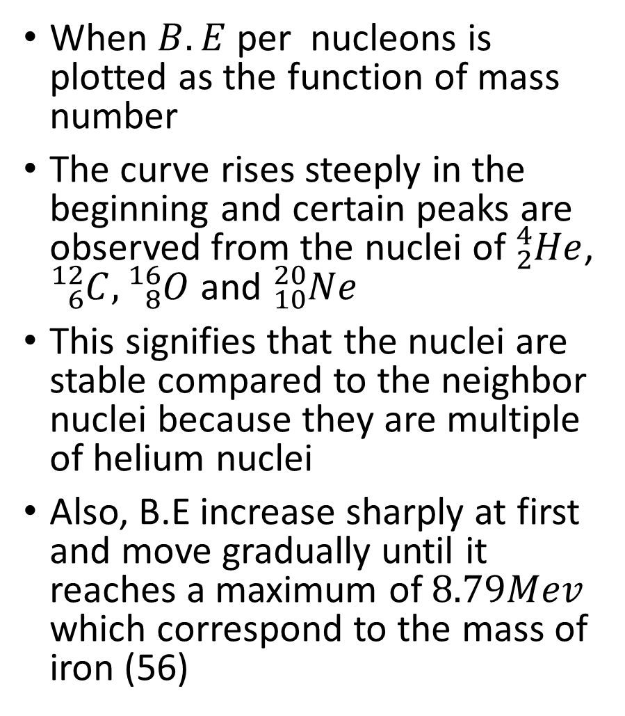
Cont...
When $B.E$ per nucleons is plotted as the function of mass number
The curve rises steeply in the beginning and certain peaks are observed from the nuclei of ${}_{2}^{4}{He}$, ${}_{6}^{12}C,{}_{8}^{16}O$ and ${}_{10}^{20}{Ne}$
This signifies that the nuclei are stable compared to the neighbor nuclei because they are multiple of helium nuclei
Also, B.E increase sharply at first and move gradually until it reaches a maximum of $8.79Mev$ which correspond to the mass of iron (56)
Consider

Slide 34
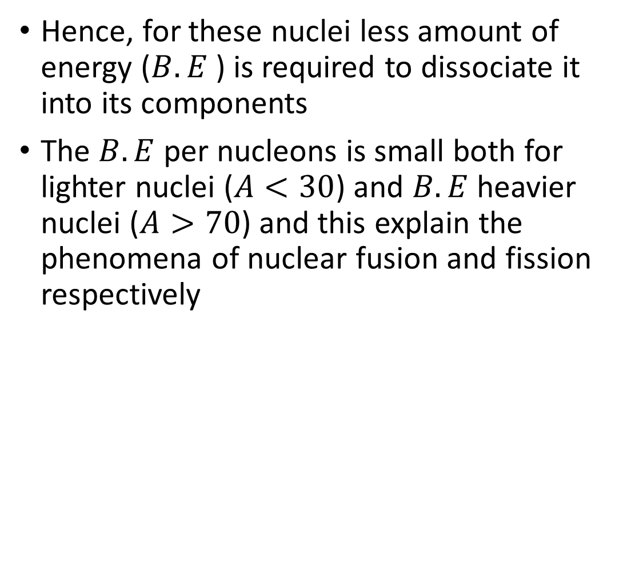
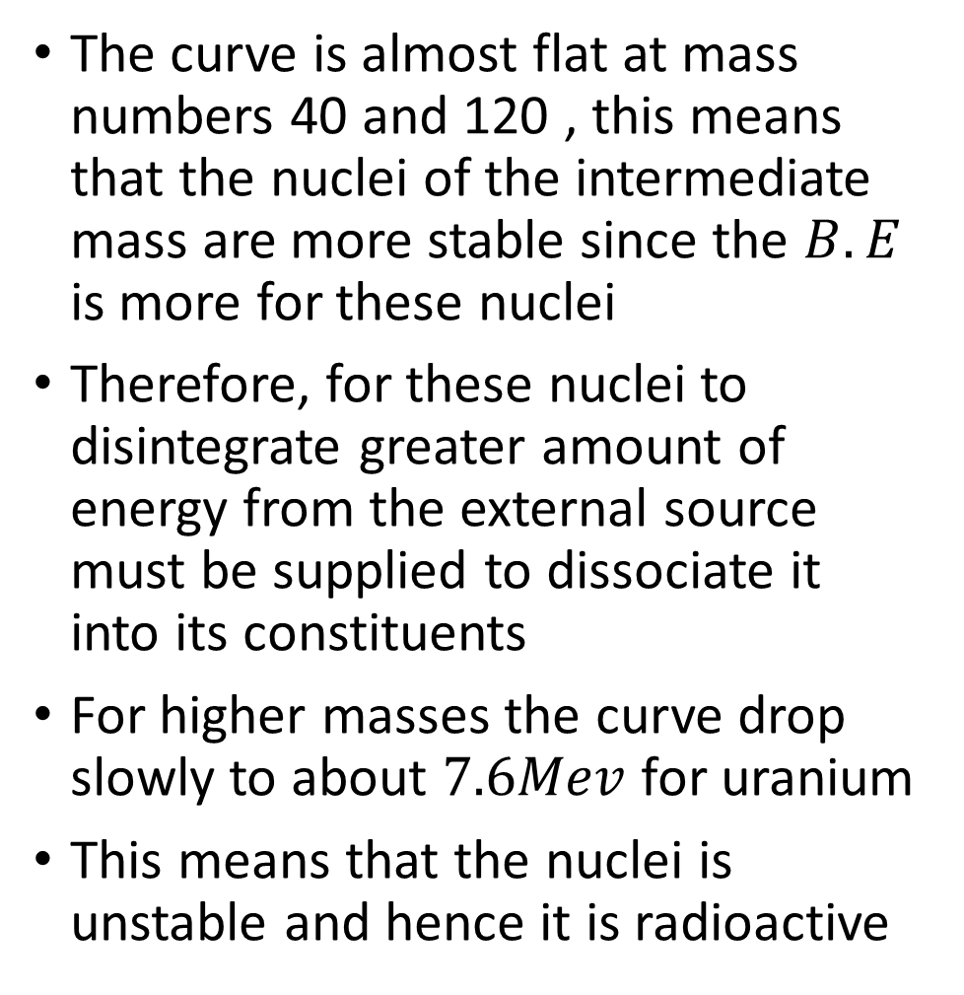
Cont...
The curve is almost flat at mass numbers 40 and 120 , this means that the nuclei of the intermediate mass are more stable since the $B.E$ is more for these nuclei
Therefore, for these nuclei to disintegrate greater amount of energy from the external source must be supplied to dissociate it into its constituents
For higher masses the curve drop slowly to about $7.6Mev$ for uranium
This means that the nuclei is unstable and hence it is radioactive
Hence, for these nuclei less amount of energy ($B.E$ ) is required to dissociate it into its components
The $B.E$ per nucleons is small both for lighter nuclei ($A<30$) and $B.E$ heavier nuclei ($A>70$) and this explain the phenomena of nuclear fusion and fission respectively

Slide 35
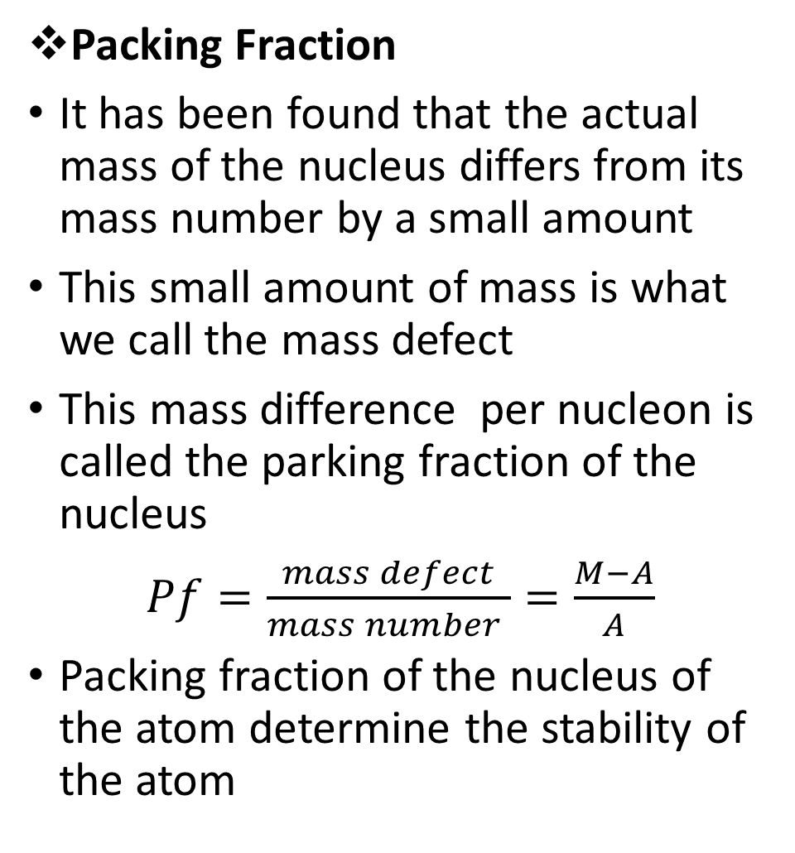
Cont...
Packing Fraction
It has been found that the actual mass of the nucleus differs from its mass number by a small amount
This small amount of mass is what we call the mass defect
This mass difference per nucleon is called the parking fraction of the nucleus
$Pf=\frac{mass defect}{mass number }=\frac{M−A}{A}$
Packing fraction of the nucleus of the atom determine the stability of the atom
The packing fraction in nuclear stability refers to the ratio of the volume occupied by the nuclei to the total volume of the atom.
Therefore, a smaller packing fraction means that the distance between nucleons is greater, reducing the repulsive forces between them and increasing the strength of the strong nuclear force, this leads to a more stable nucleus
Hence, the smaller the value of the packing fraction, the larger the stability of the nucleus

Slide 36
Cont...
Nuclear stability
Nuclear stability means that the nucleus of an element is stable and thus it does not decay spontaneously emitting any kind of radioactivity.
Some nuclei are stable, some are not.
A stable nucleus will remain in its current state indefinitely unless an outside agent interacts with it
An unstable nucleus will spontaneously change to another by emitting some kind of radioactivity.
There are some predictions to be made on predicting for stability of the nucleus among them are
Binding energy
Neutron-to-proton ratio (for larger masses)
Even-odd rule-prediction
One of the simplest ways of predicting nuclear stability is based on whether a nucleus contains an odd/even number of protons
Consider the table below

Slide 37
Cont...
Proton | Neutron | Stability
Odd | Odd | Least stable
Odd | Even | More stable
Even | Odd | Even more stable
Even | Even | Most stable

Slide 38
End

